Slide 1
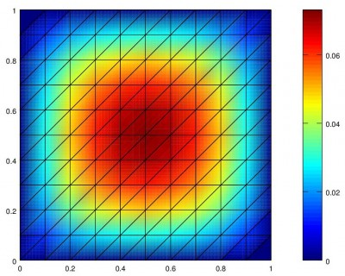

Finite element approach for a heat diffusion problem
Simulations and control
Course of “Mathematical methods for Fields”
2019/2020
Prof. Guglielmo Rubinacci
Luigi D’Amico
Alessandro Melone

Slide 2
Physical model
From the physics to the mathematical model
Mathematical method for fields
2019/2020
Luigi D’Amico
Alessandro Melone

Slide 3

Physical model
Heat Transmission
Thermodynamically, Heat is a form of energy that is transferred between two systems by virtue of a temperature difference.
Heat can be transferred in three different ways:
Conduction: heat is transmitted by the direct contact between particles of a body without any motion of the material as a whole
Convection: transport of heat as a volume of liquid or gas moves from a region of one temperature to that of another temperature
Radiation: heat propagation by means of electromagnetic waves produced by virtue of the temperature of the body
Conduction occurs in all solids, liquids and gases when a temperature gradient exists. In the fluids, the molecules have freedom of motion and energy is also transferred by movement of the fluid. However, if the fluid is at rest, the heat is transferred by conduction.
Mathematical method for fields
2019/2020
Luigi D’Amico
Alessandro Melone

Slide 4
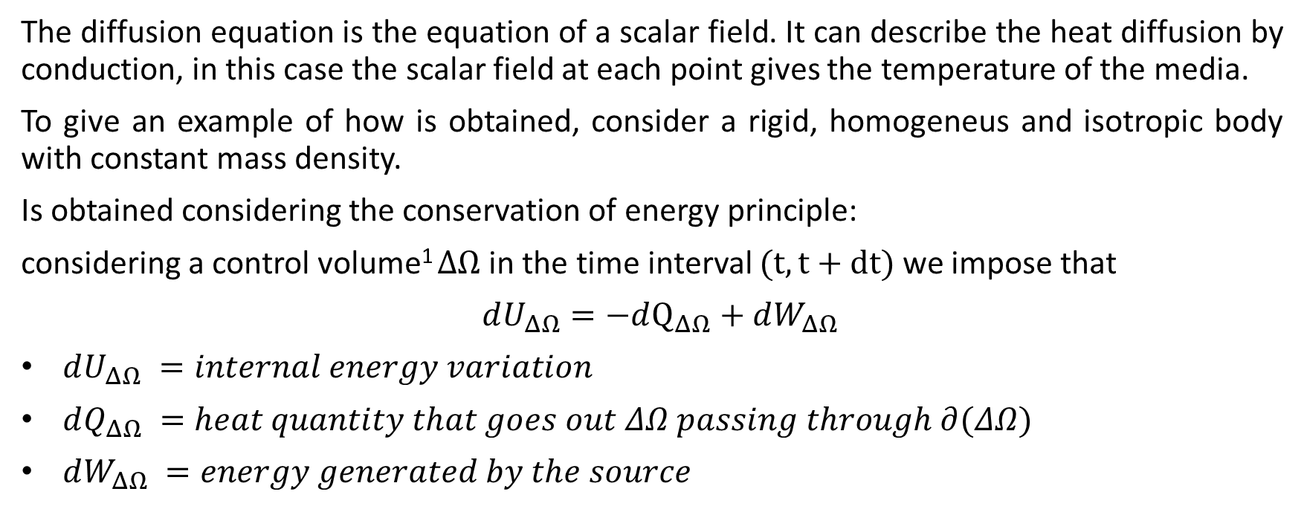
Physical problem
Heat Diffusion equation, (1/3)
1 control volume: a box shaped region so small that the field quantities can be assumed to be uniform in it
Mathematical method for fields
2019/2020
Luigi D’Amico
Alessandro Melone
Notes:
Per modellizzare la trasmissione del calore è utilizzata l’equazione di diffusione ed ora è sinteticamente mostrato come è possibile ricavarla imponendo l’equazione di bilancio energetico sul generico volume di controllo, chiamiamo delta omega questo volume di controllo
Il segno meno davanti al calore che attraversa la frontiera di delta omega è dovuto all’aumento dell’energia interna nel caso in cui il calore entra nel volume, quindi con verso opposto al versore normale alla superfice.

Slide 5
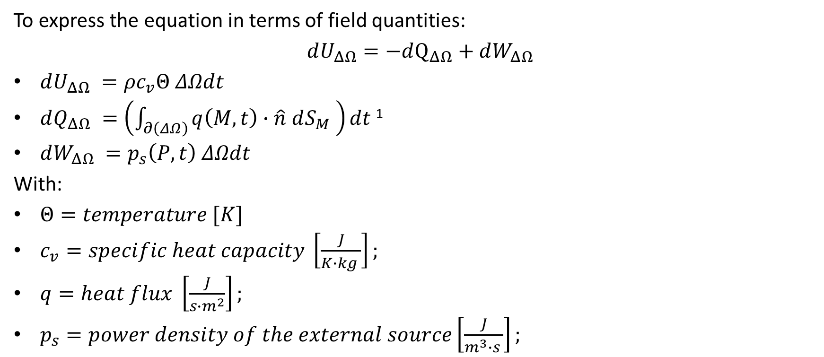
Physical problem
Heat Diffusion equation, (2/3)
Mathematical method for fields
2019/2020
Luigi D’Amico
Alessandro Melone
Notes:
Si vuole ottenere una equazione di bilancio con variabili di campo, ovvero che dipendano unicamente dallo spazio (e in aggiunta anche dal tempo), quindi si introduce la variabile di campo “temperatura” il vettore “flusso di calore” e la “densità di potenza della sorgente esterna”

Slide 6
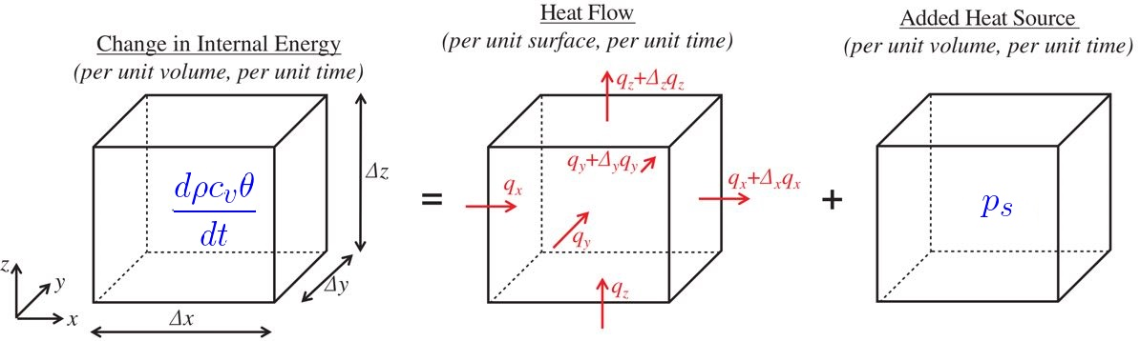
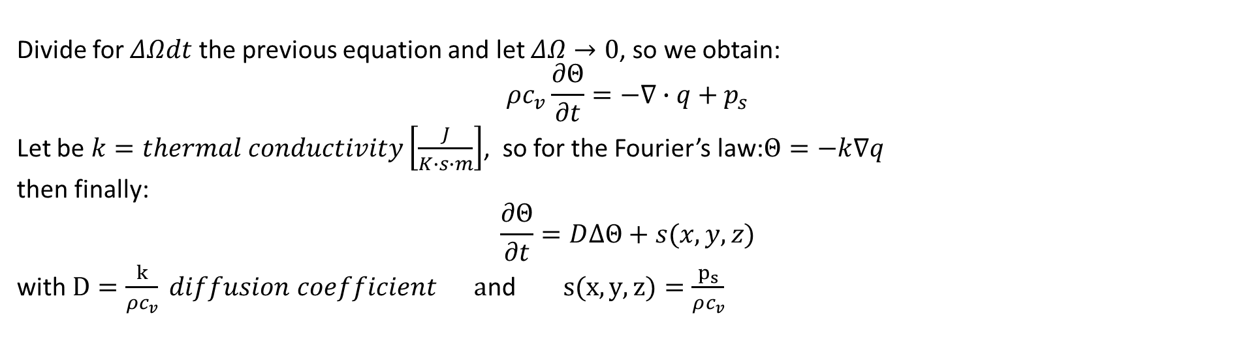
Physical problem
Heat Diffusion equation, (3/3)
Mathematical method for fields
2019/2020
Luigi D’Amico
Alessandro Melone
Notes:
Dividendo l’equazione precedente per il volume di controllo moltiplicato per dt, nel limite in cui il valore del volume di controllo tende a zero si ottiene l’equazione finale
dividere la potenza in ingresso in modo tale che l’energia totale è realistica, è come se l’utente seleziona la potenza fisica e noi la convertiamo in potenza per il nostro modello, tanto è un sistema lineare quindi ci troviamo con una semplice scalatura.
Quindi fai: potenza che usiamo ora/1200 = coeffiente che moltiplicherà la potenza settata dall’utente

Slide 7
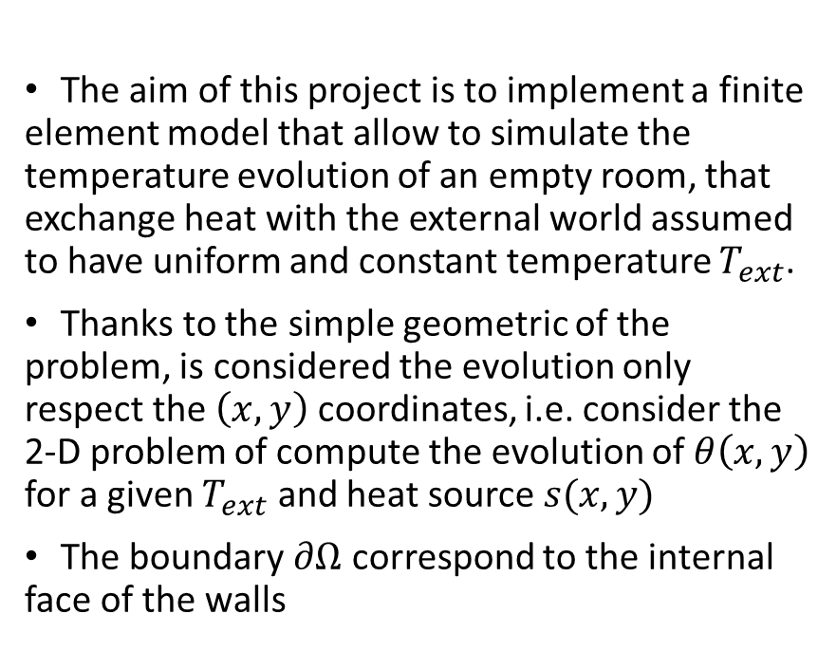
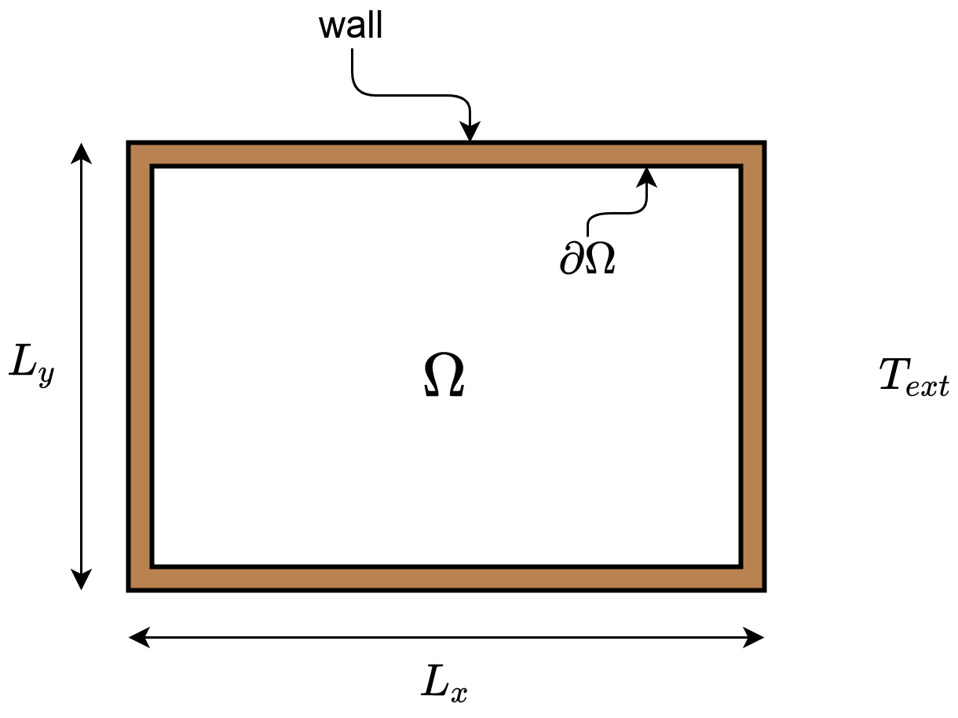
Physical problem
Case study
Mathematical method for fields
2019/2020
Luigi D’Amico
Alessandro Melone
Notes:
In questo progetto si vuole simulare l’evoluzione della temperatura in una stanza vuota, supponendo che essa scambi calore con l’esterno della stanza che è supposto essere uniformemente (nello spazio) alla temperatura T_ext

Slide 8
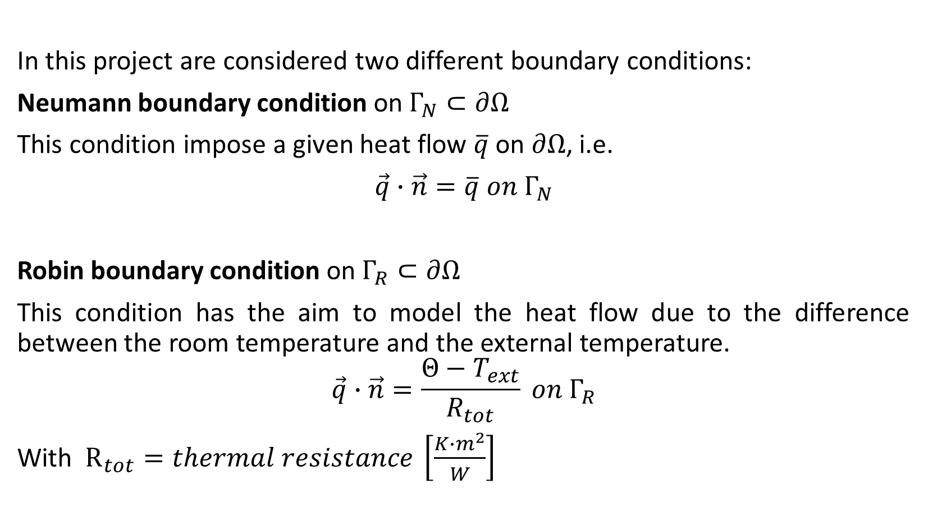
Physical problem
Boundary conditions
Mathematical method for fields
2019/2020
Luigi D’Amico
Alessandro Melone
Notes:
Sono state implementate due BC nel modello: ...

Slide 9
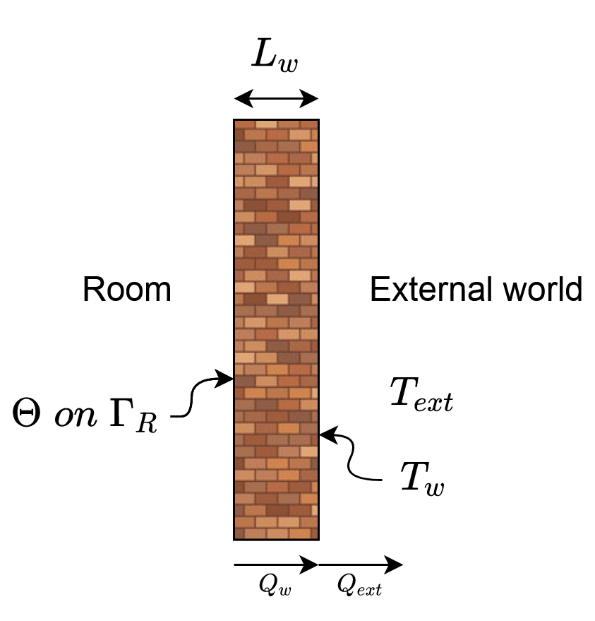
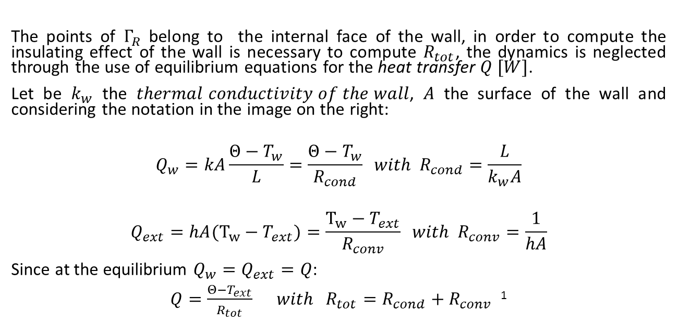
Physical problem
Computing R_{tot}
Mathematical method for fields
2019/2020
Luigi D’Amico
Alessandro Melone
Notes:
al fine di considerare l’effetto isolante della parete bisogna calcolare R_tot, per farlo sono utilizzate le equazioni di equilibrio dello scambio termico, ovvero si trascura la dinamica dell’evoluzione della temperatura nella parete, in questo modo la parete è l’equivalente di una resistenza nella teoria dei circuiti

Slide 10
Physical problem
Simplifying assumption
Numerical simulations for temperature distribution are often modeled based on Navier-Stokes Equations (NSE) for air flow coupled with an equation for heat transfer. While this approach is highly accurate and has been used successfully, heavy computational effort is required due to the nonlinearity of NSE. Thus, it is often not suitable for real-time simulations.
The approach used in this work cannot capture small-scale details but it may however capture global behaviour.
Assumed there are no windows in the room, the velocity of the air on the boundary is zero, so we will assume that the convective term (term that consider the heat exchange due to the movement of the air) is null.
Mathematical method for fields
2019/2020
Luigi D’Amico
Alessandro Melone
Notes:
Utilizzando l’equazione di diffusione bisogna tenere in conto che si trascura il moto dell’aria indotto dal gradiente termico stesso, ovvero l’innescarsi di moti convettivi e quindi il trasferimento di calore anche per moto dell’aria stessa (convezione naturale)
Queste dinamiche possono essere tenute in conto considerando le Eq. di Navier Stokes che hanno però un onere computazionale elevato, l’approccio utilizzato invece può offrire comunque un comportamento globale verosimile.
Considerando l’assenza di finestre e quindi di correnti esterne, supponiamo che l’aria è ferma e la convezione avviene solo per conduzione e non per convezione.

Slide 11
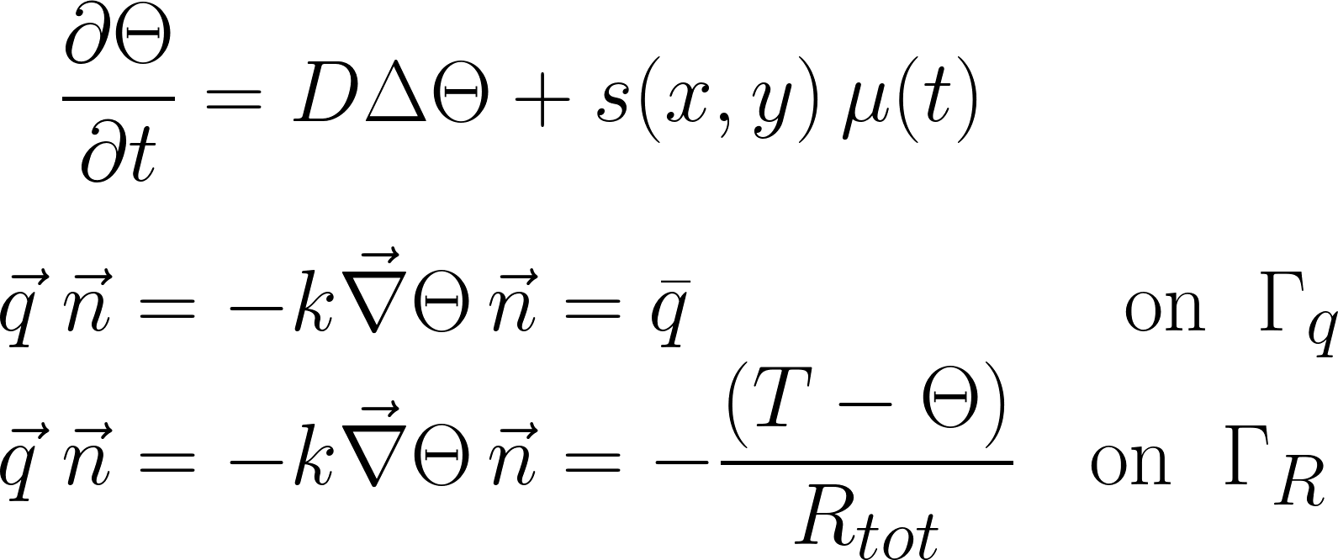

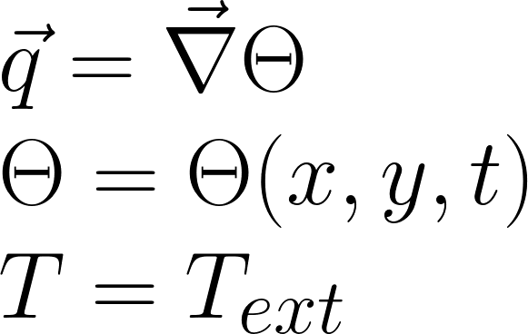
Physical model
Strong form equations
Mathematical method for fields
2019/2020
Luigi D’Amico
Alessandro Melone
Notes:
Giungiamo quindi alla forma forte del problema, si noti che assumiamo la sorgente di calore fattorizzabile in modo da separare la dipendenza dal tempo con quella dello spazio, questa assunsione consente la variazione della sorgente di calore nel tempo senza il bisogno di calcolare l’integrale ad ogni step per ottenere la matrice della fem
Questo sarà poi mostrato nelle slide successive
\\ \text{We assume that the source term can be factored in the form: $ s(x,y)\,\mu (t)$}
\\ \text{This assumption allow to compute the integral to obtain the fem matrix once and not at each step, infact those integral do not depend on t (it will be shown in after few slides)}

Slide 12
From the strong to the weak form
Mathematical derivation and equivalence
Mathematical method for fields
2019/2020
Luigi D’Amico
Alessandro Melone

Slide 13
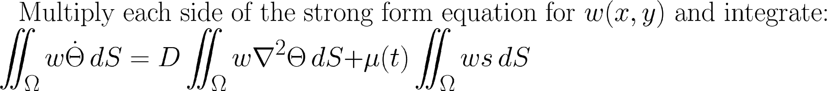
From the strong to the weak form
Derivation
Mathematical method for fields
2019/2020
Luigi D’Amico
Alessandro Melone
Notes:
Ora mostriamo il passaggio dalla forma forte alla forma debole, le funzioni test assumiamo appartengano allo spazio di sobolev
\iint_\Omega w \dot \Theta \, dV +
D \iint_\Omega \vec \nabla w \, \vec\nabla \Theta \, dV =
\iint_\Omega w s \mu \, dV
- \frac{D}{k} \int_{\Gamma_q} w \bar q \, dS +
\frac{Dh}{k} \int_{\Gamma_R} w T \, dS -
\frac{Dh}{k} \int_{\Gamma_R} w \Theta \, dS
\text{Let be $w(x,y) \in H^1(\Omega)$ with $H^1(\Omega)$ the Sobolev space, that is the space of the function } \\ \text{square-integrable with also the first derivative square-integrable.}
\text{Multiply each side of the strong form equation and integrate:}\\
\iint_\Omega w \dot \Theta \, dS=D \iint_\Omega w\nabla^2 \Theta \, dS +\mu\iint_\Omega w s \, dS
\text{
$ D \iint_\Omega w \nabla \cdot \nabla \Theta \, dS =
- D \iint_\Omega \vec \nabla w \, \vec\nabla \Theta \, dS +D\int_{\Gamma} w \vec\nabla \Theta \cdot \vec n \, d\Gamma $
}
\\ \text{Finally use the additive property of the integrals: }
\\ \text{
$D\int_{\Gamma} w \vec\nabla \Theta \cdot \vec n \, d\Gamma =
D\int_{\Gamma_N} - w \frac{\bar q }{k} \, d\Gamma_N +
D\int_{\Gamma_R} w \frac{T-\Theta }{k R_{tot}} \, d\Gamma_R
$
}
\\ \text{In conclusion:} \\
\text { $ \iint_\Omega w \dot \Theta \, dS +
D \iint_\Omega \vec \nabla w \, \vec\nabla \Theta \, dS =
\mu(t)\iint_\Omega w s \, dS
- \frac{D}{k} \int_{\Gamma_N} w \bar q \, dS +
\frac{D}{kR_{tot}} \int_{\Gamma_R} w T \, dS -
\frac{D}{kR_{tot}} \int_{\Gamma_R} w \Theta \, dS $
}

Slide 14
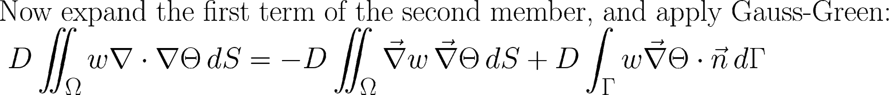
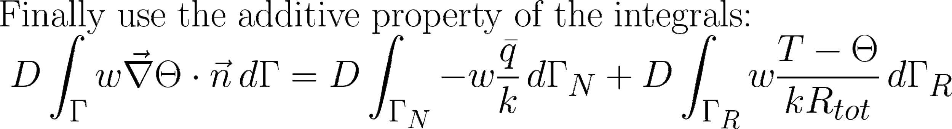
From the strong to the weak form
Derivation
Mathematical method for fields
2019/2020
Luigi D’Amico
Alessandro Melone
Notes:
Ora mostriamo il passaggio dalla forma forte alla forma debole, le funzioni test assumiamo appartengano allo spazio di sobolev
\iint_\Omega w \dot \Theta \, dV +
D \iint_\Omega \vec \nabla w \, \vec\nabla \Theta \, dV =
\iint_\Omega w s \mu \, dV
- \frac{D}{k} \int_{\Gamma_q} w \bar q \, dS +
\frac{Dh}{k} \int_{\Gamma_R} w T \, dS -
\frac{Dh}{k} \int_{\Gamma_R} w \Theta \, dS
\text{Let be $w(x,y) \in H^1(\Omega)$ with $H^1(\Omega)$ the Sobolev space, that is the space of the function } \\ \text{square-integrable with also the first derivative square-integrable.}
\text{Multiply each side of the strong form equation and integrate:}\\
\iint_\Omega w \dot \Theta \, dS=D \iint_\Omega w\nabla^2 \Theta \, dS +\mu\iint_\Omega w s \, dS
\text{
$ D \iint_\Omega w \nabla \cdot \nabla \Theta \, dS =
- D \iint_\Omega \vec \nabla w \, \vec\nabla \Theta \, dS +D\int_{\Gamma} w \vec\nabla \Theta \cdot \vec n \, d\Gamma $
}
\\ \text{Finally use the additive property of the integrals: }
\\ \text{
$D\int_{\Gamma} w \vec\nabla \Theta \cdot \vec n \, d\Gamma =
D\int_{\Gamma_N} - w \frac{\bar q }{k} \, d\Gamma_N +
D\int_{\Gamma_R} w \frac{T-\Theta }{k R_{tot}} \, d\Gamma_R
$
}
\\ \text{In conclusion:} \\
\text { $ \iint_\Omega w \dot \Theta \, dS +
D \iint_\Omega \vec \nabla w \, \vec\nabla \Theta \, dS =
\mu(t)\iint_\Omega w s \, dS
- \frac{D}{k} \int_{\Gamma_N} w \bar q \, dS +
\frac{D}{kR_{tot}} \int_{\Gamma_R} w T \, dS -
\frac{D}{kR_{tot}} \int_{\Gamma_R} w \Theta \, dS $
}

Slide 15
From the strong to the weak form
Derivation
Mathematical method for fields
2019/2020
Luigi D’Amico
Alessandro Melone
Notes:
Ora mostriamo il passaggio dalla forma forte alla forma debole, le funzioni test assumiamo appartengano allo spazio di sobolev
\iint_\Omega w \dot \Theta \, dV +
D \iint_\Omega \vec \nabla w \, \vec\nabla \Theta \, dV =
\iint_\Omega w s \mu \, dV
- \frac{D}{k} \int_{\Gamma_q} w \bar q \, dS +
\frac{Dh}{k} \int_{\Gamma_R} w T \, dS -
\frac{Dh}{k} \int_{\Gamma_R} w \Theta \, dS
\text{Let be $w(x,y) \in H^1(\Omega)$ with $H^1(\Omega)$ the Sobolev space, that is the space of the function } \\ \text{square-integrable with also the first derivative square-integrable.}
\text{Multiply each side of the strong form equation and integrate:}\\
\iint_\Omega w \dot \Theta \, dS=D \iint_\Omega w\nabla^2 \Theta \, dS +\mu\iint_\Omega w s \, dS
\text{
$ D \iint_\Omega w \nabla \cdot \nabla \Theta \, dS =
- D \iint_\Omega \vec \nabla w \, \vec\nabla \Theta \, dS +D\int_{\Gamma} w \vec\nabla \Theta \cdot \vec n \, d\Gamma $
}
\\ \text{Finally use the additive property of the integrals: }
\\ \text{
$D\int_{\Gamma} w \vec\nabla \Theta \cdot \vec n \, d\Gamma =
D\int_{\Gamma_N} - w \frac{\bar q }{k} \, d\Gamma_N +
D\int_{\Gamma_R} w \frac{T-\Theta }{k R_{tot}} \, d\Gamma_R
$
}
\\ \text{In conclusion:} \\
\text { $ \iint_\Omega w \dot \Theta \, dS +
D \iint_\Omega \vec \nabla w \, \vec\nabla \Theta \, dS =
\mu(t)\iint_\Omega w s \, dS
- \frac{D}{k} \int_{\Gamma_N} w \bar q \, dS +
\frac{D}{kR_{tot}} \int_{\Gamma_R} w T \, dS -
\frac{D}{kR_{tot}} \int_{\Gamma_R} w \Theta \, dS $
}

Slide 16
From the strong to the weak form
Consideration
The equation above is the weak form and can be proved that is equivalent to the strong form
Is named weak form because the regularity condition imposed on the temperature field function are less demanding respect that of the strong form: is not necessary that exist the Laplacian of the solution, but just the first derivative.
The f.e.m. approach used in this project wants to find a piecewise approximation of the solution, so the second derivative exist only in the sense of distributions. For this reason it was necessary to introduce the weak form.
Mathematical method for fields
2019/2020
Luigi D’Amico
Alessandro Melone
Notes:
\iint_\Omega w \dot \Theta \, dV +
D \iint_\Omega \vec \nabla w \, \vec\nabla \Theta \, dV =
\iint_\Omega w s \mu \, dV
- \frac{D}{k} \int_{\Gamma_q} w \bar q \, dS +
\frac{Dh}{k} \int_{\Gamma_R} w T \, dS -
\frac{Dh}{k} \int_{\Gamma_R} w \Theta \, dS
\text{Let be $w(x,y) \in H^1(\Omega)$ with $H^1(\Omega)$ the Sobolev space, that is the space of the function } \\ \text{square-integrable with also the first derivative square-integrable.}
\text{Multiply each side of the strong form equation and integrate:}\\
\iint_\Omega w \dot \Theta \, dS=D \iint_\Omega w\nabla^2 \Theta \, dS +\mu\iint_\Omega w s \, dS
\text{
$ D \iint_\Omega w \nabla \cdot \nabla \Theta \, dS =
- D \iint_\Omega \vec \nabla w \, \vec\nabla \Theta \, dS +D\int_{\Gamma} w \vec\nabla \Theta \cdot \vec n \, d\Gamma $
}
\\ \text{Finally use the additive property of the integrals: }
\\ \text{
$D\int_{\Gamma} w \vec\nabla \Theta \cdot \vec n \, d\Gamma =
D\int_{\Gamma_N} - w \frac{\bar q }{k} \, d\Gamma_N +
D\int_{\Gamma_R} w \frac{T-\Theta }{k R_{tot}}} \, d\Gamma_R
$
}
\\ \text{In conclusion:} \\
\text { $ \iint_\Omega w \dot \Theta \, dS +
D \iint_\Omega \vec \nabla w \, \vec\nabla \Theta \, dS =
\mu(t)\iint_\Omega w s \, dS
- \frac{D}{k} \int_{\Gamma_N} w \bar q \, dS +
\frac{D}{kR_{tot}} \int_{\Gamma_R} w T \, dS -
\frac{D}{kR_{tot}} \int_{\Gamma_R} w \Theta \, dS $
}

Slide 17
Finite Element Method
Implementation of the 2D FEM algorithm with triangle elements
Mathematical method for fields
2019/2020
Luigi D’Amico
Alessandro Melone

Slide 18
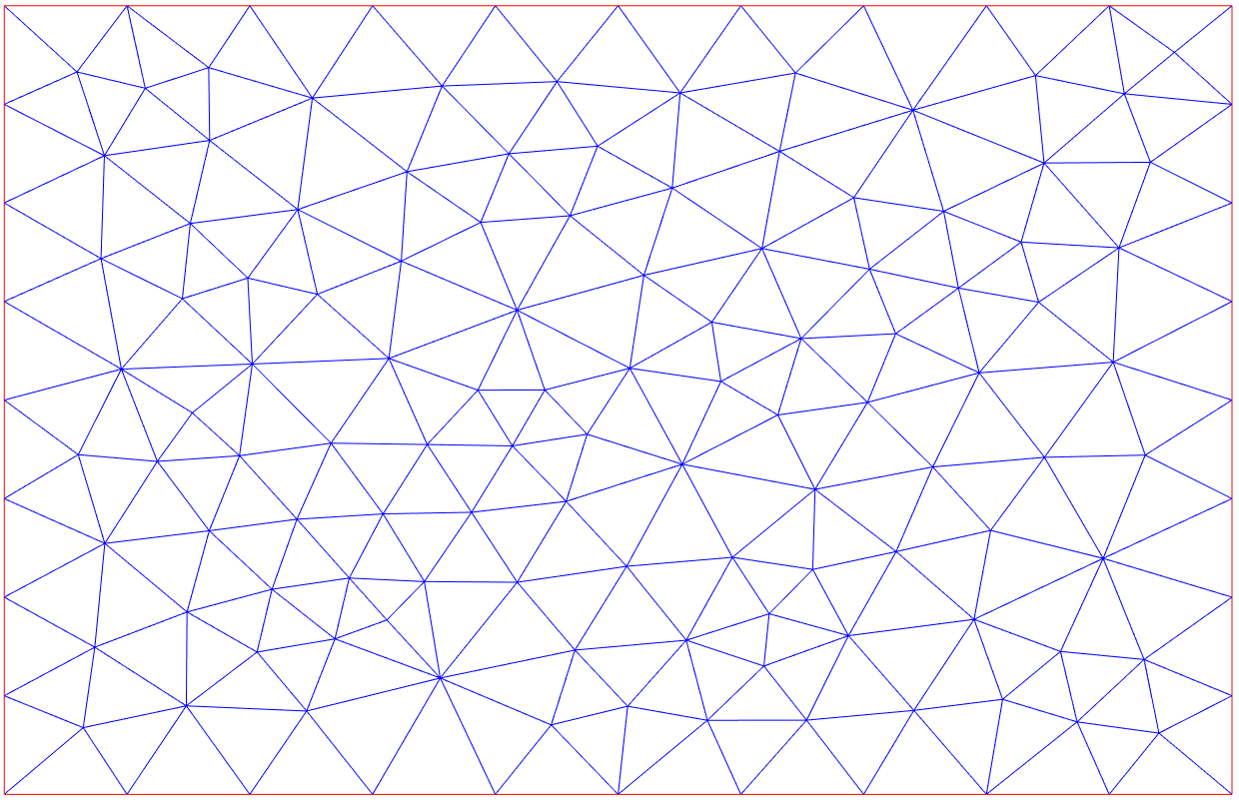
Finite Element Method
Introduction
The f.e.m. approach wants to approximate the functional space in which to find the solution, the approximate solution and the test function will belong to the functional space of the piecewise function.
The two-dimensional domain Ω is discretized into N_{e} triangular subdomains (elements). Each element consists of 3 nodes.
Mathematical method for fields
2019/2020
Luigi D’Amico
Alessandro Melone
Notes:
\Theta ^{(e)}(x,y) = [N^{(e)}] \{\Theta^{(e)}\}
[N^{(e)}] = [N^{(e)}_1(x,y)\;\; N^{(e)}_2(x,y)\;\; N^{(e)}_1(x,y)]
\{\Theta^{(e)}\} = [\Theta^{(e)}_1 \;\; \Theta^{(e)}_2 \;\; \Theta^{(e)}_3]^T

Slide 19
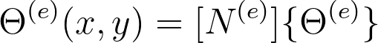
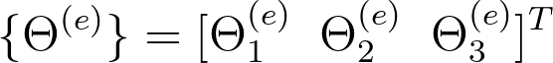
Finite Element Method
Introduction
The f.e.m. approach wants to approximate the functional space in which to find the solution, the approximate solution and the test function will belong to the functional space of the piecewise function.
The two-dimensional domain Ω is discretized into N_{e} triangular subdomains (elements). Each element consists of 3 nodes.
We will rely on a piecewise approximation, therefore we will stipulate the approximation of the field for each element separately.
The approximate temperature field in element e will be given by a polynomial expression involving shape functions and the nodal temperature vector of the element.
Shape function array of the element
Nodal temperature vector of the element
Mathematical method for fields
2019/2020
Luigi D’Amico
Alessandro Melone
Notes:
\Theta ^{(e)}(x,y) = [N^{(e)}] \{\Theta^{(e)}\}
[N^{(e)}] = [N^{(e)}_1(x,y)\;\; N^{(e)}_2(x,y)\;\; N^{(e)}_1(x,y)]
\{\Theta^{(e)}\} = [\Theta^{(e)}_1 \;\; \Theta^{(e)}_2 \;\; \Theta^{(e)}_3]^T

Slide 20
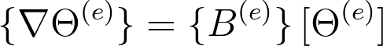
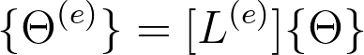
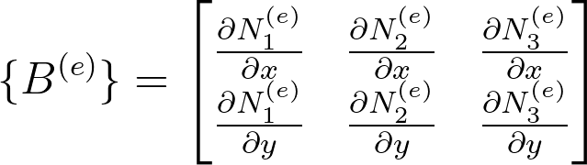
Finite Element Method
Node temperature and weighting functions
We can also define the gradient of the nodal temperature
The nodal values of each element e, are given from the global node vector by a gather operation
Mathematical method for fields
2019/2020
Luigi D’Amico
Alessandro Melone
Notes:
\{ \nabla \Theta ^{(e)} \} = \{B^{(e)}\} \, [\Theta^{(e)}]
\{B^{(e)}\} =
\begin{bmatrix}
\frac{\partial N_1^{(e)}}{\partial x} & \frac{\partial N_2^{(e)}}{\partial x} & \frac{\partial N_3^{(e)}}{\partial x} \\
\frac{\partial N_1^{(e)}}{\partial y} & \frac{\partial N_2^{(e)}}{\partial y} & \frac{\partial N_3^{(e)}}{\partial y}
\end{bmatrix}
\{ \Theta^{(e)} \} = [L^{(e)}] \{\Theta\}
\{\Theta\} \text{: temperature values of all the nodal points in the finite element mesh}
[L^{(e)}] \text{: gather array of element } e
\{ \nabla w ^{(e)} \} = \{B^{(e)}\} \, [W^{(e)}]
w^{(e)}(x,y) = [N^{(e)}] \{W^{(e)}\} =\{W^{(e)}\}^T [N^{(e)}]^T
\{W^{(e)}\} \text{: Nodal values of weighting functions for element }e
\{ W^{(e)} \} = [L^{(e)}] \{W\}

Slide 21
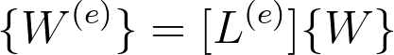
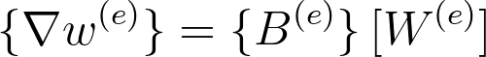
Finite Element Method
Node temperature and weighting functions
We can also define the gradient of the nodal temperature
The nodal values of each element e, are given from the global node vector by a gather operation
The piecewise approximation for the actual field is also used for the weighting functions field, w(x,y)
Mathematical method for fields
2019/2020
Luigi D’Amico
Alessandro Melone
Notes:
\{ \nabla \Theta ^{(e)} \} = \{B^{(e)}\} \, [\Theta^{(e)}]
\{B^{(e)}\} =
\begin{bmatrix}
\frac{\partial N_1^{(e)}}{\partial x} & \frac{\partial N_2^{(e)}}{\partial x} & \frac{\partial N_3^{(e)}}{\partial x} \\
\frac{\partial N_1^{(e)}}{\partial y} & \frac{\partial N_2^{(e)}}{\partial y} & \frac{\partial N_3^{(e)}}{\partial y}
\end{bmatrix}
\{ \Theta^{(e)} \} = [L^{(e)}] \{\Theta\}
\{\Theta\} \text{: temperature values of all the nodal points in the finite element mesh}
[L^{(e)}] \text{: gather array of element } e
\{ \nabla w ^{(e)} \} = \{B^{(e)}\} \, [W^{(e)}]
w^{(e)}(x,y) = [N^{(e)}] \{W^{(e)}\} =\{W^{(e)}\}^T [N^{(e)}]^T
\{W^{(e)}\} \text{: Nodal values of weighting functions for element }e
\{ W^{(e)} \} = [L^{(e)}] \{W\}

Slide 22
Finite Element Method
How to solve the weak form
Mathematical method for fields
2019/2020
Luigi D’Amico
Alessandro Melone

Slide 23
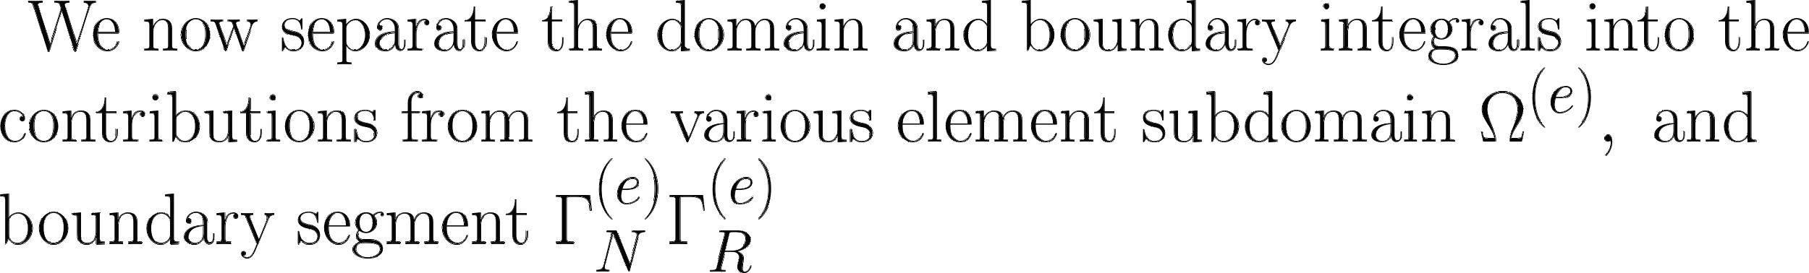
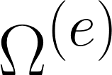
Finite Element Method
How to solve the weak form
Mathematical method for fields
2019/2020
Luigi D’Amico
Alessandro Melone

Slide 24
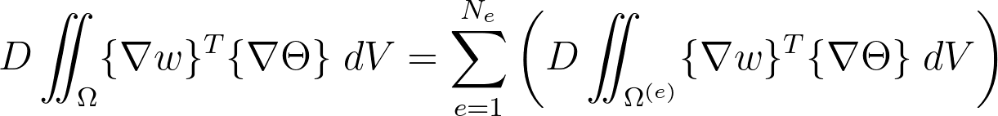
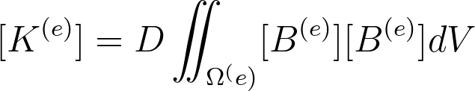
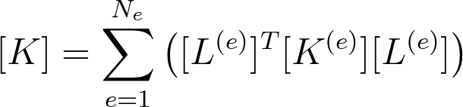
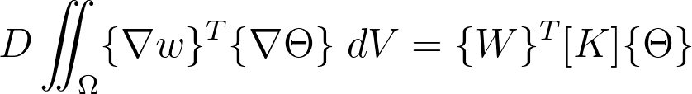
Finite Element Method
Left side, 2nd term
Mathematical method for fields
2019/2020
Luigi D’Amico
Alessandro Melone
Notes:
D \iint_\Omega \{\nabla w \}^T \{\nabla \Theta \} \; dV = \sum_{e=1}^{N_e} \left( D \iint_{\Omega^{(e)}} \{\nabla w \}^T \{\nabla \Theta \} \; dV \right)
D \iint_{\Omega^{(e)}} \{\nabla w \}^T \{\nabla \Theta \} \; dV = \{W^{(e)}\}^T [K^{(e)}] \{\Theta^{(e)}\} = \{W\}^T [L^{(e)}]^T [K^{(e)}][L^{(e)}] \{\Theta\}
D \iint_\Omega \{\nabla w \}^T \{\nabla \Theta \} \; dV = \{W\}^T [K] \{\Theta\}
[K^{(e)}] = D \iint_{\Omega^(e)} [B^{(e)}] [B^{(e)}] dV
[K] = \sum_{e=1}^{N_e} \left( [L^{(e)}]^T [K^{(e)}] [L^{(e)}] \right )

Slide 25
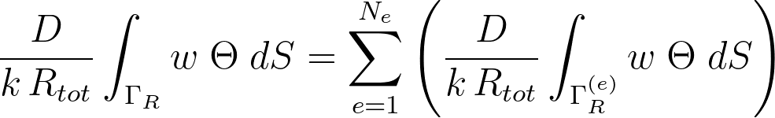
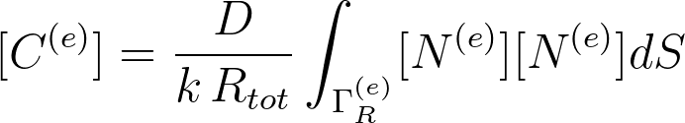
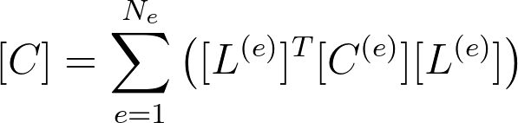
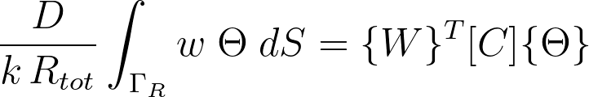
Finite Element Method
Right side, 4th term
Mathematical method for fields
2019/2020
Luigi D’Amico
Alessandro Melone
Notes:
\frac{D\,h}{k} \int_{\Gamma_R} w \; \Theta \; dS = \sum_{e=1}^{N_e} \left( \frac{D\,h}{k} \int_{\Gamma_R^{(e)}} w \; \Theta \; dS \right)
\frac{D\,h}{k} \iint_{\Gamma_R^{(e)}} w \; \Theta \; dS = \{W^{(e)}\}^T [C^{(e)}] \{\Theta^{(e)}\} = \{W\}^T [L^{(e)}]^T [C^{(e)}][L^{(e)}] \{\Theta\}
\frac{D\,h}{k} \int_{\Gamma_R} w \; \Theta \; dS = \{W\}^T [C] \{\Theta\}
[C^{(e)}] = \frac{D\,h}{k} \int_{\Gamma_R^{(e)}} [N^{(e)}] [N^{(e)}] dS
[C] = \sum_{e=1}^{N_e} \left( [L^{(e)}]^T [C^{(e)}] [L^{(e)}] \right )

Slide 26
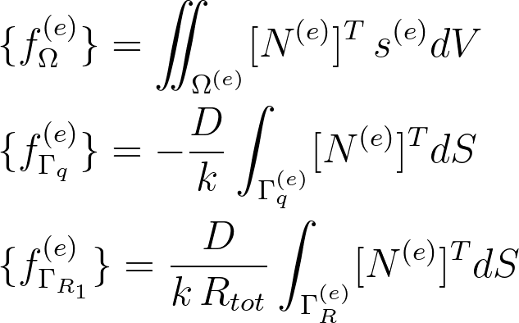
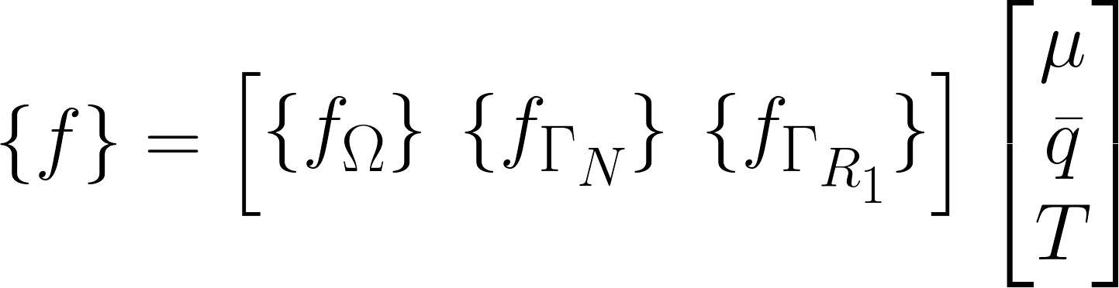
Finite Element Method
Right side, 1st 2nd 3rd term
Mathematical method for fields
2019/2020
Luigi D’Amico
Alessandro Melone
Notes:
- \frac{D}{k} \int_{\Gamma_q} w \, \bar q \; dS +
\frac{D\,h}{k} \int_{\Gamma_R} w \, T \; dS +
\iint_\Omega w\, s \, \mu \; dV
=
\{W\}^T \{f\}
\{f\} = \begin{bmatrix}
\{f_\Omega\} &
\{f_{\Gamma_q}\} &
\{f_{\Gamma_{R_1}}\}
\end{bmatrix}
\begin{bmatrix}
\mu \\
\bar q \\
T
\end{bmatrix}
\begin{align*}
&\{f_\Omega^{(e)}\} = \iint_{\Omega^{(e)}} [N^{(e)}]^T\, s^{(e)} dV \\
&\{f_{\Gamma_q}^{(e)}\} = -\frac{D}{k} \int_{\Gamma_q^{(e)}} [N^{(e)}]^T dS \\
&\{f_{\Gamma_{R_1}}^{(e)}\} = \frac{D\,h}{k} \int_{\Gamma_{R}^{(e)}} [N^{(e)}]^T dS \\
\end{align}

Slide 27
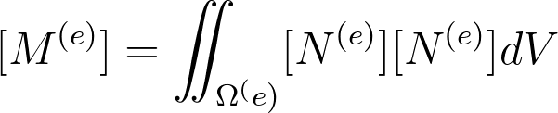
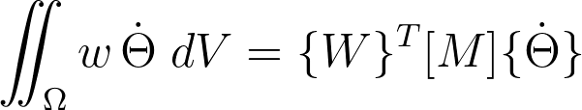

Finite Element Method
Left side, 1st term
Mathematical method for fields
2019/2020
Luigi D’Amico
Alessandro Melone
Notes:
\iint_\Omega w \,\dot \theta \; dV =
\{W\}^T [M] \{\dot \Theta\}
[M^{(e)}] = \iint_{\Omega^(e)} [N^{(e)}] [N^{(e)}] dV
[M] = \sum_{e=1}^{N_e} \left( [L^{(e)}]^T [M^{(e)}] [L^{(e)}] \right )

Slide 28
Finite Element Method
Matrix formula for the weak form
Putting all terms together...
Mathematical method for fields
2019/2020
Luigi D’Amico
Alessandro Melone
Notes:
\{W\}^T [M] \{\dot\Theta\} + \{W\}^T [K] \{\Theta\} =
- \{W\}^T [C] \{\Theta\} + \{W\}^T \{f\}
[M] \{\dot \Theta\} + [L] \{\Theta\} = \{f\}
[L] = [K] + [C]

Slide 29
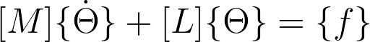

Finite Element Method
Matrix formula for the weak form
Putting all terms together...
Once the FEM algorithm has been runned, the quantities [M] [K] [C] {f} is obtained.
A linear dynamic system in the 𝚯 variable has to be solved in order to obtain the nodal temperature vector.
Mathematical method for fields
2019/2020
Luigi D’Amico
Alessandro Melone
Notes:
\{W\}^T [M] \{\dot\Theta\} + \{W\}^T [K] \{\Theta\} =
- \{W\}^T [C] \{\Theta\} + \{W\}^T \{f\}
[M] \{\dot \Theta\} + [L] \{\Theta\} = \{f\}
[L] = [K] + [C]

Slide 30
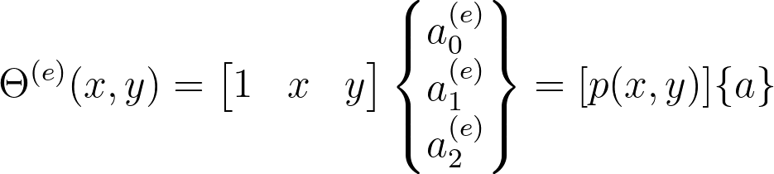
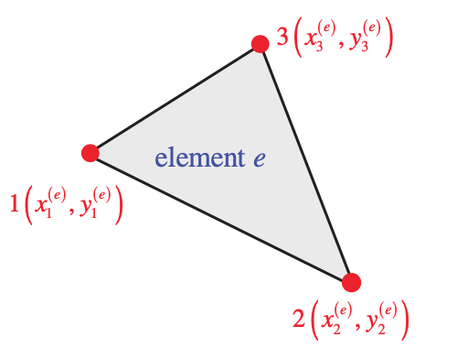
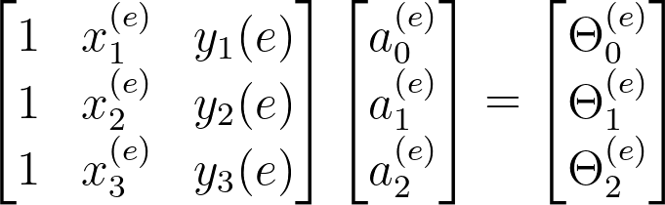
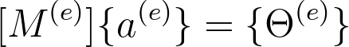
Finite Element Method
Shape functions, 1
We have three nodes and we want to introduce a polynomial interpolation for the temperature of the element e
We impose that the temperature at each nodal points is equal to the corresponding nodal temperature
Mathematical method for fields
2019/2020
Luigi D’Amico
Alessandro Melone
Notes:
\Theta ^{(e)}(x,y) =
\begin{bmatrix}
1 & x & y
\end{bmatrix}
\begin{Bmatrix}
a_0^{(e)} \\ a_1^{(e)} \\ a_2^{(e)}
\end{Bmatrix}
= [p(x,y)] \{a \}
\begin{bmatrix}
1 & x_1^{(e)} & y_1{(e)} \\
1 & x_2^{(e)} & y_2{(e)} \\
1 & x_3^{(e)} & y_3{(e)}
\end{bmatrix}
=
\begin{bmatrix}
a_0^{(e)} \\ a_1^{(e)} \\a_2^{(e)}
\end{bmatrix}
=
\begin{bmatrix}
\Theta_0^{(e)} \\ \Theta_1^{(e)} \\ \Theta_2^{(e)}
\end{bmatrix}
[M^{(e)}] \{a^{(e)}\} = \{ \Theta^{(e)}\}

Slide 31
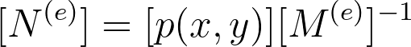
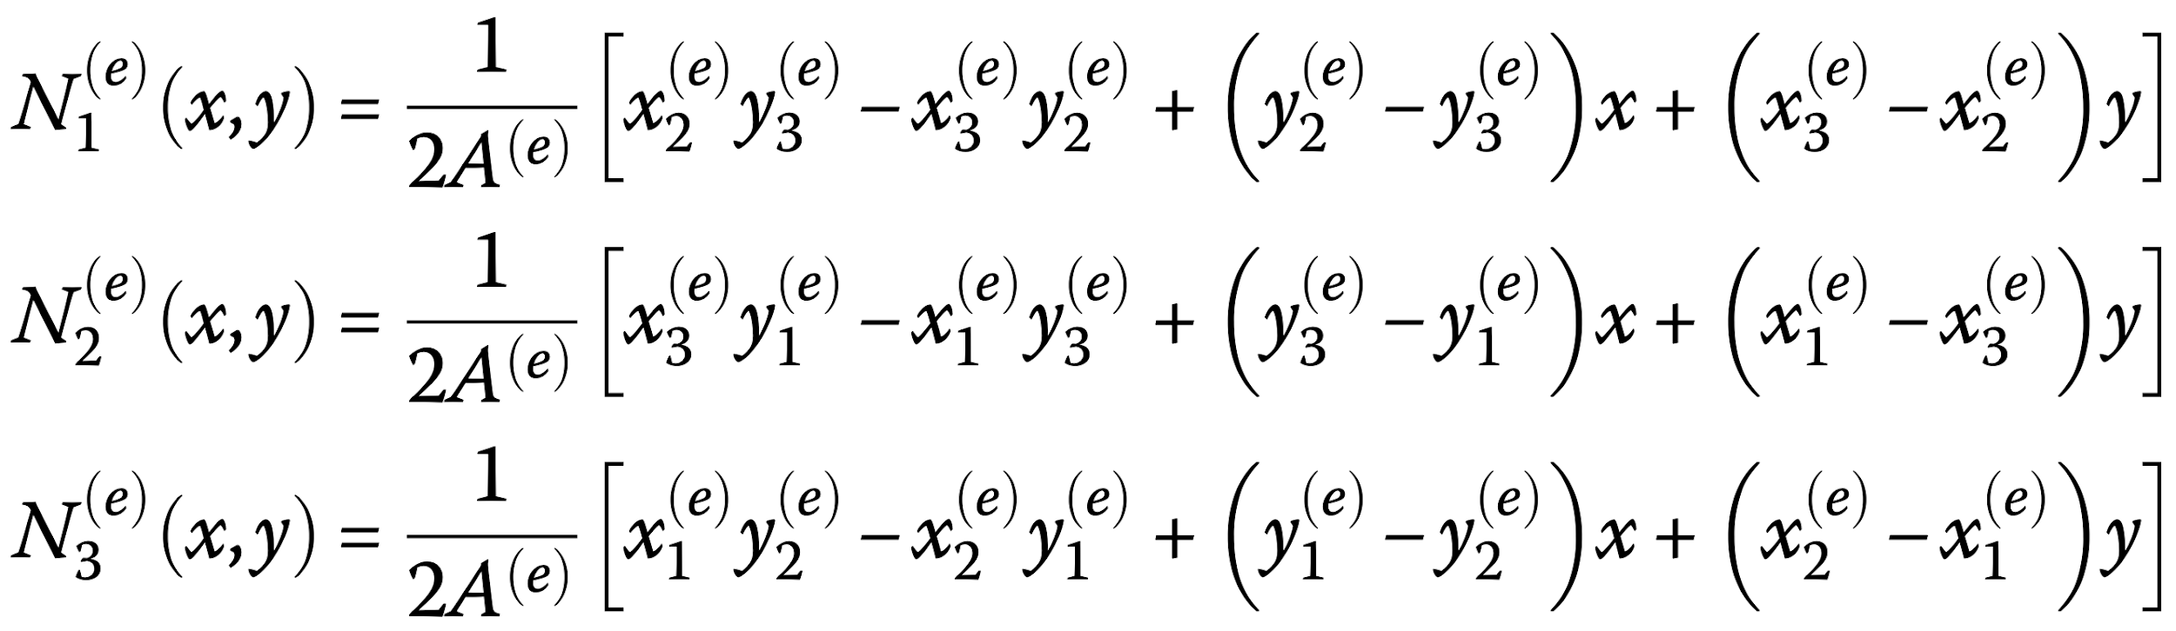
Finite Element Method
Shape functions, 2
We obtain an expression for the shape function
If one does the math, the following expression are obtained for the three shape functions
where A^{(e)} is the area of the element, obtained from the nodal coordinates as follows
Mathematical method for fields
2019/2020
Luigi D’Amico
Alessandro Melone
Notes:
\Theta ^{(e)}(x,y) = [p(x,y)] [M^{(e)}]^{-1} \{\Theta^{(e)}\}
[N^{(e)}] = [p(x,y)] [M^{(e)}]^{-1}

Slide 32
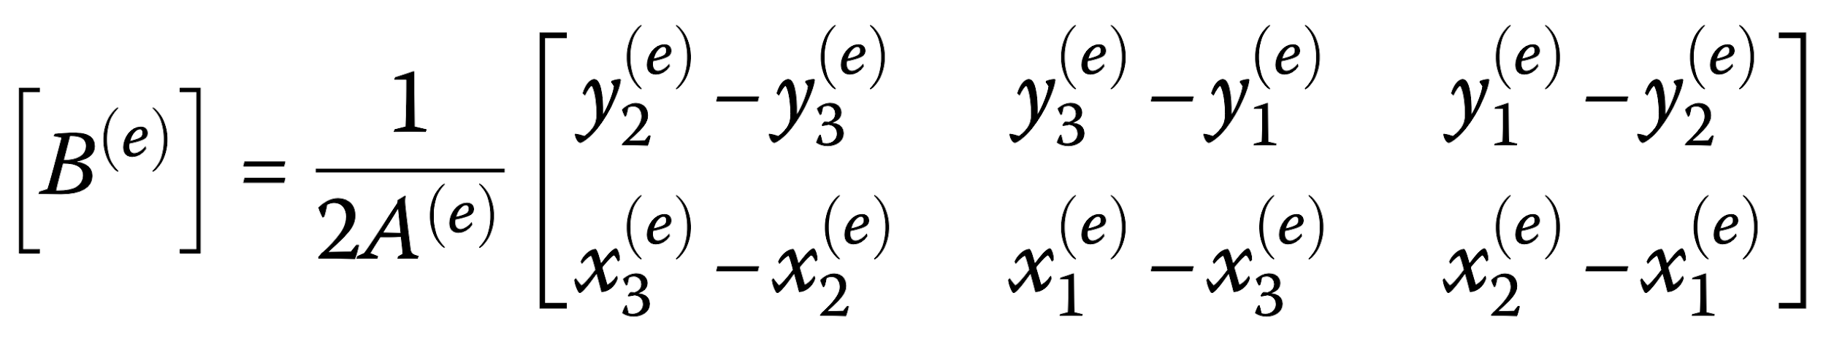
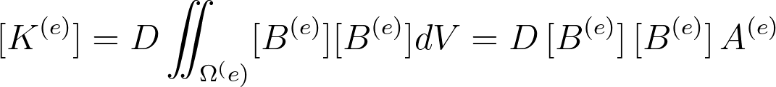
Finite Element Method
Stiffness matrix [K]
Through the matrix [B^{(e)}] we can also obtain the shape functions partial derivatives with respect to x and y.
[B^{(e)}] for the three-node triangular element is constant (it does not depend on x and y).
It’s now possible to compute the [K^{(e)}] matrix.
Note that numerical error is not present here because [B^{(e)}] can be extracted from the integral
Mathematical method for fields
2019/2020
Luigi D’Amico
Alessandro Melone
Notes:
[K^{(e)}] = D \iint_{\Omega^(e)} [B^{(e)}] [B^{(e)}] dV = D \, [B^{(e)}] \, [B^{(e)}] \, A^{(e)}

Slide 33
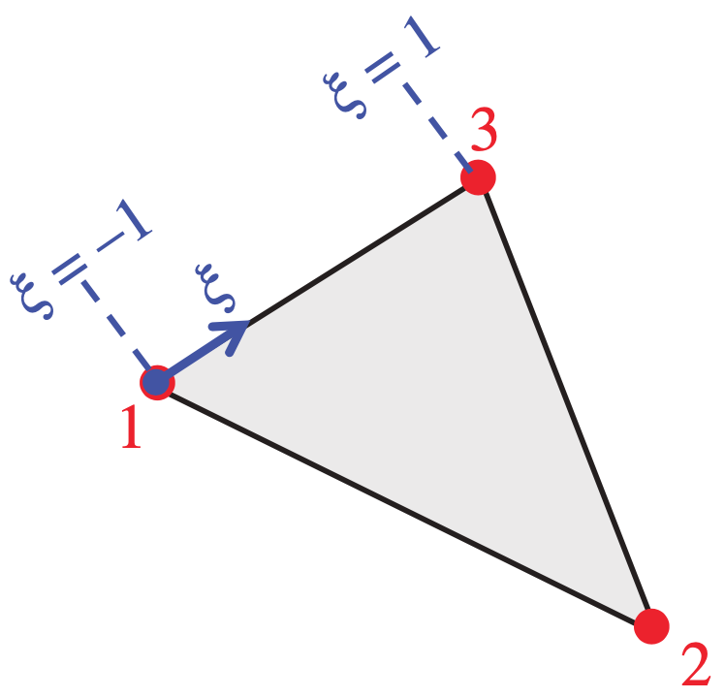
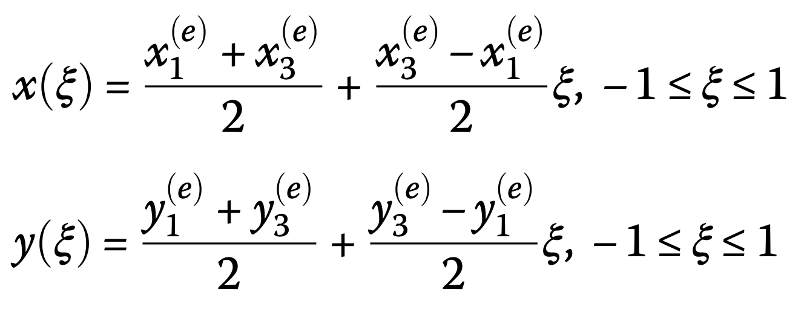
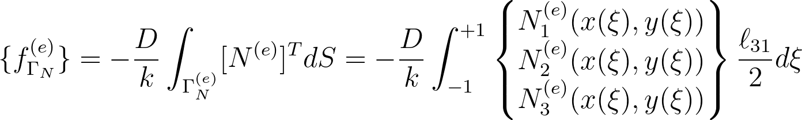
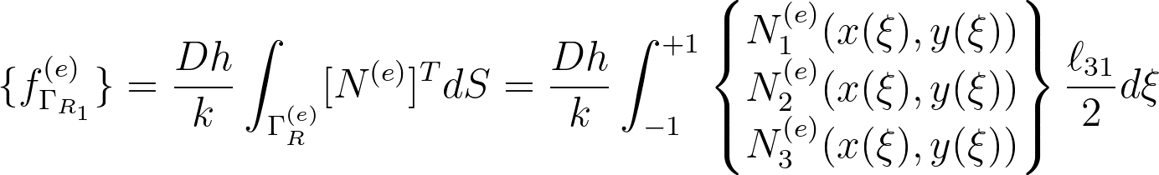


Finite Element Method
Vector {f}
For the boundary condition, we parametrize the boundary segment.
Since the natural boundary of the element is a line segment, we can describe the position of a point along this segment by means of a single parameter ξ
It’s now possible compute the integral term in function of ξ variable.
The integrals are evaluated using the 1D gaussian quadrature
Mathematical method for fields
2019/2020
Luigi D’Amico
Alessandro Melone
Notes:
\{f_{\Gamma_q}^{(e)}\} = - \frac{D}{k} \int_{\Gamma_q^{(e)}} [N^{(e)}]^T dS = - \frac{D}{k} \int_{-1}^{+1}
\begin{Bmatrix}
N_1^{(e)}(x(\xi),y(\xi)) \\
N_2^{(e)}(x(\xi),y(\xi)) \\
N_3^{(e)}(x(\xi),y(\xi))
\end{Bmatrix}
\frac{\ell_{31}}{2} d\xi
\{f_{\Gamma_{R_1}}^{(e)}\} = \frac{Dh}{k} \int_{\Gamma_{R}^{(e)}} [N^{(e)}]^T dS = \frac{D h}{k} \int_{-1}^{+1}
\begin{Bmatrix}
N_1^{(e)}(x(\xi),y(\xi)) \\
N_2^{(e)}(x(\xi),y(\xi)) \\
N_3^{(e)}(x(\xi),y(\xi))
\end{Bmatrix}
\frac{\ell_{31}}{2} d\xi

Slide 34





Finite Element Method
Matrix [M] and {f_{𝛀}}
The isoparametric concept is used to integrate over the triangular domain.
Natural coordinates approach: given a node P in the interior of the element, the three areas of the three sub-triangles are defined.
ξ₁ and ξ₂ can be used to establish the isoparametric element
We can now establish the associated mapping
Mathematical method for fields
2019/2020
Luigi D’Amico
Alessandro Melone
Notes:
\begin{align*}
&\xi_1 = \frac{A_1}{A^{(e)}} \\
&\xi_2 = \frac{A_2}{A^{(e)}} \\
&\xi_3 = \frac{A_3}{A^{(e)}} = 1- \xi_1 - \xi_2\\
\end{align}
\begin{align*}
x(\xi_1,\xi_2) = \sum_{i=1}^3 N_i^{(3T)} (\xi_1, xi_2) \, x_i^{(e)} \\
y(\xi_1,\xi_2) = \sum_{i=1}^3 N_i^{(3T)} (\xi_1, xi_2) \, y_i^{(e)}
\end{align}
\begin{align*}
x(\xi_1,\xi_2) = \sum_{i=1}^3 N_i^{(3T)} (\xi_1, xi_2) \, x_i^{(e)} \\
y(\xi_1,\xi_2) = \sum_{i=1}^3 N_i^{(3T)} (\xi_1, xi_2) \, y_i^{(e)}
\end{align}

Slide 35



Finite Element Method
Matrix [M] and {f_{𝛀}}
We now establish the shape functions in the parametric (natural) coordinate space
Concerning the integration, for any function we can use the change-of-coordinates formula to obtain
This formula is used to compute the surface integral for [M^{(e)}] and {f_{Ω}^{(e)}}
Numerical quadrature can then be used to evaluate domain integrals
Mathematical method for fields
2019/2020
Luigi D’Amico
Alessandro Melone
Notes:
\begin{align*}
x(\xi_1,\xi_2) = \sum_{i=1}^3 N_i^{(3T)} (\xi_1, xi_2) \, x_i^{(e)} \\
y(\xi_1,\xi_2) = \sum_{i=1}^3 N_i^{(3T)} (\xi_1, xi_2) \, y_i^{(e)}
\end{align}

Slide 36

Finite Element Method
Steady-state case
Output of the FEM algorithm: [L] {f}
A linear algebraic system has to be solved to obtain the nodal temperature vector {𝚯}.
The command “\” in Matlab has been used.
Mathematical method for fields
2019/2020
Luigi D’Amico
Alessandro Melone
Notes:
\{W\}^T [M] \{\dot\Theta\} + \{W\}^T [K] \{\Theta\} =
- \{W\}^T [C] \{\Theta\} + \{W\}^T \{f\}
[M] \{\dot \Theta\} + [L] \{\Theta\} = \{f\}
[L] = [K] + [C]

Slide 37

Finite Element Method
Steady-state case
Output of the FEM algorithm: [L] {f}
A linear algebraic system has to be solved to obtain the nodal temperature vector {𝚯}.
The command “\” in Matlab has been used.
Unsteady case
Output of the FEM algorithm: [M] [L] {f_{Ω}} {f_{N}} {f_{R1}}
A linear dynamic system in the {𝚯} variable and with time-variant input has to be solved in order to obtain the nodal temperature vector.
Mathematical method for fields
2019/2020
Luigi D’Amico
Alessandro Melone
Notes:
\{W\}^T [M] \{\dot\Theta\} + \{W\}^T [K] \{\Theta\} =
- \{W\}^T [C] \{\Theta\} + \{W\}^T \{f\}
[M] \{\dot \Theta\} + [L] \{\Theta\} = \{f\}
[L] = [K] + [C]

Slide 38
FEM Code Verification
execution of the order-of-accuracy test through the MMS method
Mathematical method for fields
2019/2020
Luigi D’Amico
Alessandro Melone

Slide 39
FEM code verification
Verification and Validation
Verification and validation provide a means for assessing the credibility and accuracy of mathematical models and their subsequent simulations.
Verification: assessing the numerical accuracy of a simulation relative to the true solution to the mathematical model. Is composed by two parts:
code verification
solution verification
Validation: assessment of the accuracy of the mathematical model relative to the observations of nature that come in the form of experimental measurements. In this case the relationship of the strong form model with the natural phenomena is proved. In other words is checked if is solved the right equation.
In this project is not considered the validation problem, because there is no physical experiment to observe.
Mathematical method for fields
2019/2020
Luigi D’Amico
Alessandro Melone

Slide 40
FEM code verification
Verification problem
•Code Verification: the goal is to ensure that the code is a faithful representation of the underlying mathematical model. Thus assess both the correctness of the chosen numerical algorithm and the correctness of the instantiation of that algorithm into written source code (i.e. there are no coding mistakes).
In other words (considering the Roache’s definition), it is a procedure to demonstrate that the discretization error decreases to zero as the mesh dimensions decreases to zero through the verification of the order-of-accuracy.
•Solution Verification: the goal is the estimation the magnitude (and not the order like the code verification) of the numerical errors that occur when the governing equations are discretized and solved numerically.
Mathematical method for fields
2019/2020
Luigi D’Amico
Alessandro Melone
Notes:
\begin{align*}
&D \nabla^2 \Theta = - s(x,y) \, \bar \mu \; ,\; \bar \mu = 1\\ \\
&\vec q \; \vec n = - k \vec \nabla \Theta \, \vec n = - h \, (T - \Theta) \; \; \; \text{on} \; \; \Gamma_R\\
\end{align}
\Gamma_R = \{\partial \Omega_1, \partial \Omega_2, \partial \Omega_3, \partial \Omega_4\}
\text{Assume } \, T = 0
\begin{align*}
&\text{BC on } \partial \Omega_1 \Rightarrow \frac{\partial\Theta}{\partial y}(x,L_y) = -\frac{h}{k} \Theta(x,L_y) \\
&\text{BC on } \partial \Omega_2 \Rightarrow \frac{\partial\Theta}{\partial x}(L_x,y) = -\frac{h}{k} \Theta(L_x,y) \\
&\text{BC on } \partial \Omega_3 \Rightarrow \frac{\partial\Theta}{\partial x}(x,0) = +\frac{h}{k} \Theta(x,0) \\
&\text{BC on } \partial \Omega_4 \Rightarrow \frac{\partial\Theta}{\partial x}(0,y) = +\frac{h}{k} \Theta(0,y)
\end{align}

Slide 41

FEM code verification
Order-of-accuracy test (1/2)
Mathematical method for fields
2019/2020
Luigi D’Amico
Alessandro Melone
Notes:
\begin{align*}
&D \nabla^2 \Theta = - s(x,y) \, \bar \mu \; ,\; \bar \mu = 1\\ \\
&\vec q \; \vec n = - k \vec \nabla \Theta \, \vec n = - h \, (T - \Theta) \; \; \; \text{on} \; \; \Gamma_R\\
\end{align}
\Gamma_R = \{\partial \Omega_1, \partial \Omega_2, \partial \Omega_3, \partial \Omega_4\}
\text{Assume } \, T = 0
\begin{align*}
&\text{BC on } \partial \Omega_1 \Rightarrow \frac{\partial\Theta}{\partial y}(x,L_y) = -\frac{h}{k} \Theta(x,L_y) \\
&\text{BC on } \partial \Omega_2 \Rightarrow \frac{\partial\Theta}{\partial x}(L_x,y) = -\frac{h}{k} \Theta(L_x,y) \\
&\text{BC on } \partial \Omega_3 \Rightarrow \frac{\partial\Theta}{\partial x}(x,0) = +\frac{h}{k} \Theta(x,0) \\
&\text{BC on } \partial \Omega_4 \Rightarrow \frac{\partial\Theta}{\partial x}(0,y) = +\frac{h}{k} \Theta(0,y)
\end{align}

Slide 42

FEM code verification
Order-of-accuracy test (2/2)
Mathematical method for fields
2019/2020
Luigi D’Amico
Alessandro Melone
Notes:
\begin{align*}
&D \nabla^2 \Theta = - s(x,y) \, \bar \mu \; ,\; \bar \mu = 1\\ \\
&\vec q \; \vec n = - k \vec \nabla \Theta \, \vec n = - h \, (T - \Theta) \; \; \; \text{on} \; \; \Gamma_R\\
\end{align}
\Gamma_R = \{\partial \Omega_1, \partial \Omega_2, \partial \Omega_3, \partial \Omega_4\}
\text{Assume } \, T = 0
\begin{align*}
&\text{BC on } \partial \Omega_1 \Rightarrow \frac{\partial\Theta}{\partial y}(x,L_y) = -\frac{h}{k} \Theta(x,L_y) \\
&\text{BC on } \partial \Omega_2 \Rightarrow \frac{\partial\Theta}{\partial x}(L_x,y) = -\frac{h}{k} \Theta(L_x,y) \\
&\text{BC on } \partial \Omega_3 \Rightarrow \frac{\partial\Theta}{\partial x}(x,0) = +\frac{h}{k} \Theta(x,0) \\
&\text{BC on } \partial \Omega_4 \Rightarrow \frac{\partial\Theta}{\partial x}(0,y) = +\frac{h}{k} \Theta(0,y)
\end{align}

Slide 43


FEM Code verification
Mesh refinement
pdetool of Partial Differential Equation toolbox by MatLab is used to generate the triangulation of the domain.
The uniform mesh refinement is obtained by dividing each triangle side in two parts, therefore from one triangle 4 triangles are obtained.
The discretization parameter is h = Δl / Δl_{ref} with Δl be the average triangle side length and Δl_{ref} is computed on the more coarse mesh.
Note that the mesh refinement is uniform despite the mesh are not uniform.
Mathematical method for fields
2019/2020
Luigi D’Amico
Alessandro Melone
Notes:
\\ \text{Let be $h=\frac{\Delta l}{\Delta l_{ref}} $ with $\Delta l_{ref}=0.3288 $ i.e. the average lenght for the more coarse mesh}
\\ \text{
The uniform mesh refinement is obtained by dividing each triangle side in two parts, therefore from one triangle is obtained 4 triangles.
}

Slide 44
FEM code verification
Finding the exact solution
In order to achieve the exact solution the main approaches are two:
Method of Exact Solutions (MES): find the exact solution by solving the governing equations, for the given boundary and initial conditions. The exact solution for complex problem often depend on significant simplifications in dimensionality, geometry, physics, etc…
Method of Manufactured Solutions (MMS): choose a solution a priori that respect the boundary and initial conditions, then plug this solution in the governing equations and find the corresponding source term.
For code verification purposes, is not required that the manufactured solution be related to a physically realistic problem (e.g. the heat source could be meaningless in our case).
The manufactured solutions should be analytic functions with smooth derivatives. Trigonometric and exponential functions are recommended.
Mathematical method for fields
2019/2020
Luigi D’Amico
Alessandro Melone
Notes:
\begin{align*}
&D \nabla^2 \Theta = - s(x,y) \, \bar \mu \; ,\; \bar \mu = 1\\ \\
&\vec q \; \vec n = - k \vec \nabla \Theta \, \vec n = - h \, (T - \Theta) \; \; \; \text{on} \; \; \Gamma_R\\
\end{align}
\Gamma_R = \{\partial \Omega_1, \partial \Omega_2, \partial \Omega_3, \partial \Omega_4\}
\text{Assume } \, T = 0
\begin{align*}
&\text{BC on } \partial \Omega_1 \Rightarrow \frac{\partial\Theta}{\partial y}(x,L_y) = -\frac{h}{k} \Theta(x,L_y) \\
&\text{BC on } \partial \Omega_2 \Rightarrow \frac{\partial\Theta}{\partial x}(L_x,y) = -\frac{h}{k} \Theta(L_x,y) \\
&\text{BC on } \partial \Omega_3 \Rightarrow \frac{\partial\Theta}{\partial x}(x,0) = +\frac{h}{k} \Theta(x,0) \\
&\text{BC on } \partial \Omega_4 \Rightarrow \frac{\partial\Theta}{\partial x}(0,y) = +\frac{h}{k} \Theta(0,y)
\end{align}

Slide 45

FEM Code verification
Construct manufactured solution (steady state case) (1/2)
Mathematical method for fields
2019/2020
Luigi D’Amico
Alessandro Melone
Notes:
\begin{align*}
&D \nabla^2 \Theta = - s(x,y) \, \bar \mu \; ,\; \bar \mu = 1\\ \\
&\vec q \; \vec n = - k \vec \nabla \Theta \cdot \hat n = -\frac{T - \Theta}{R_{tot}} \; \; \; \text{on} \; \; \Gamma_R\\
\end{align}
\\ \text{Given that: $\Gamma_R = \{\partial \Omega_1, \partial \Omega_2, \partial \Omega_3, \partial \Omega_4\} $:}
\text{Assume $T = 0$ the BC become: $\vec \nabla \Theta \cdot \hat n = \bigl[ \begin{smallmatrix} \Theta_1 (x,y) & \Theta_2 (x,y) \end{smallmatrix}\bigr]\bigl[ \begin{smallmatrix} n_1(x,y)\\n_2(x,y)\end{smallmatrix}\bigr]=-\frac{\Theta(x,y)}{kR_{tot}} \;\forall (x,y)\in \Gamma_R$ }
\text{$\text{BC on } \partial \Omega_1 \; \text{where $\hat n = \bigl[ \begin{smallmatrix} 0\\1\end{smallmatrix}\bigr] $} \Rightarrow
\vec \nabla \Theta \cdot \hat n = \frac{\partial\Theta}{\partial y}(x,L_y) = -\frac{\Theta(x,L_y)}{kR_{tot}} , \forall x \in [0;L_x] \\$}
\text{$\text{BC on } \partial \Omega_2 \; \text{where $\hat n = \bigl[ \begin{smallmatrix} 1\\0\end{smallmatrix}\bigr] $} \Rightarrow
\frac{\partial\Theta}{\partial y}(L_x,y) = -\frac{\Theta(L_x,y)}{kR_{tot}} , \forall x \in [0;L_y] \\$}
\text{$\text{BC on } \partial \Omega_3 \; \text{where $\hat n = \bigl[ \begin{smallmatrix} 0\\1\end{smallmatrix}\bigr] $} \Rightarrow
\frac{\partial\Theta}{\partial y}(x,0) = -\frac{\Theta(x,0)}{kR_{tot}} , \forall x \in [0;L_x] \\$}
\text{$\text{BC on } \partial \Omega_4 \; \text{where $\hat n = \bigl[ \begin{smallmatrix} -1\\0\end{smallmatrix}\bigr] $} \Rightarrow
\frac{\partial\Theta}{\partial x}(x,0) = -\frac{\Theta(0,y)}{kR_{tot}} , \forall y \in [0;L_y] \\$}
&\text{BC on } \partial \Omega_2 \Rightarrow \frac{\partial\Theta}{\partial x}(L_x,y) = -\frac{h}{k} \Theta(L_x,y) \\
&\text{BC on } \partial \Omega_3 \Rightarrow \frac{\partial\Theta}{\partial x}(x,0) = +\frac{h}{k} \Theta(x,0) \\
&\text{BC on } \partial \Omega_4 \Rightarrow \frac{\partial\Theta}{\partial x}(0,y) = +\frac{h}{k} \Theta(0,y)
\end{align}
\begin{align*}
&\text{$\text{BC on } \partial \Omega_1 \; \text{where $\hat n = \bigl( \begin{smallmatrix} 0\\1\end{smallmatrix}\bigr) $} \Rightarrow
\vec \nabla \Theta \cdot \hat n = \frac{\partial\Theta}{\partial y}(x,L_y) = -\frac{h}{k} \Theta(x,L_y), \forall x \in [0,L_x] \\$}
&\text{BC on } \partial \Omega_2 \Rightarrow \frac{\partial\Theta}{\partial x}(L_x,y) = -\frac{h}{k} \Theta(L_x,y) \\
&\text{BC on } \partial \Omega_3 \Rightarrow \frac{\partial\Theta}{\partial x}(x,0) = +\frac{h}{k} \Theta(x,0) \\
&\text{BC on } \partial \Omega_4 \Rightarrow \frac{\partial\Theta}{\partial x}(0,y) = +\frac{h}{k} \Theta(0,y)
\end{align}

Slide 46

FEM Code verification
Construct manufactured solution (steady state case) (2/2)
Mathematical method for fields
2019/2020
Luigi D’Amico
Alessandro Melone
Notes:
\\ \text{Choice the solution with this form: $\Theta(x,y) = e^{p(x)} \, e^{g(y)}$}
\text{$ \Theta_x(x,y) = p_x(x)\,e^{p(x)} e^{g(y)} \Rightarrow
\begin{matrix}
&\text{on } \partial \Omega_2 \;\; p_x(L_x) = -\frac{1}{kR_{tot}} \\
&\text{on } \partial \Omega_4 \;\;\;\; p_x(0) = +\frac{1}{kR_{tot}}
\end{matrix} \;
\Rightarrow
p_x(x) = (1-\frac{2}{L_x}x)\frac{1}{kR_{tot}}
\Rightarrow
p(x) = x(1-\frac{1}{L_x}x) \frac{1}{kR_{tot}} + C_x
$}
\\ \text{$
\Theta_y(x,y) = g_y(y)\,e^{p(x)} e^{g(y)} \Rightarrow
\begin{matrix}
&\text{on } \partial \Omega_1 \;\; g_y(L_y) = -\frac{1}{kR_{tot}} \\
&\text{on } \partial \Omega_3 \;\;\;\; g_y(0) = +\frac{1}{kR_{tot}}
\end{matrix} \;
\Rightarrow
g_y(y) = (1-\frac{2}{L_y}y)\frac{1}{kR_{tot}}
\Rightarrow
g(y) = y(1-\frac{1}{L_y}y) \frac{1}{kR_{tot}} + C_y
$}
\begin{align*}
&\Theta_x(x,y) = p_x(x)\,e^{p(x)} e^{g(y)} \Rightarrow
\begin{matrix}
&\text{on } \partial \Omega_2 \;\; p_x(L_x) = -\frac{1}{kR_{tot}} \\
&\text{on } \partial \Omega_4 \;\;\;\; p_x(0) = +\frac{1}{kR_{tot}}
\end{matrix} \;
\Rightarrow
p_x(x) = (1-\frac{2}{L_x}x)\frac{1}{kR_{tot}}
\Rightarrow
p(x) = x(1-\frac{1}{L_x}x) \frac{1}{kR_{tot}} + C_x
\\ \\
&\Theta_y(x,y) = g_y(y)\,e^{p(x)} e^{g(y)} \Rightarrow
\begin{matrix}
&\text{on } \partial \Omega_1 \;\; g_y(L_y) = -\frac{1}{kR_{tot}} \\
&\text{on } \partial \Omega_3 \;\;\;\; g_y(0) = +\frac{1}{kR_{tot}}
\end{matrix} \;
\Rightarrow
g_y(y) = (1-\frac{2}{L_y}y)\frac{1}{kR_{tot}}
\Rightarrow
g(y) = y(1-\frac{1}{L_y}y) \frac{1}{kR_{tot}} + C_y
\end{align}
\\ \text{Thus: $
\begin{matrix}
p(x) = x(1-\frac{1}{L_x}x) \frac{1}{kR_{tot}} \\
g(y) = y(1-\frac{1}{L_y}y) \frac{1}{kR_{tot}}
\end{matrix}
$}
\\ \text{Finally: $
s(x,y) = -D \nabla^2 \Theta = -D (p_{xx} + p_x^2 + p_{yy}+p_y^2) e^{p(x)} e^{g(x)}
$}

Slide 47




FEM code verification
Test results (steady state case)
First, compute the error norms considering the true solution and the numerical solutions obtained with different mesh refinements.
L2 norm is computed using gaussian quadrature
Hinf norm is computed considering the nodal values
Mathematical method for fields
2019/2020
Luigi D’Amico
Alessandro Melone
Notes:
\\ \text{The slope of the straight line passing through two points $k$ and $k+1$ is the observed order of accuracy, and can be computed using:}
\\ \text{$\hat \rho_k = \frac{ln( \| \frac{\varepsilon_{2kh}}{\varepsilon_{kh}}\| )}{ln(\|2\|)}$ for $k=1,2,4$}
\begin{center}
\begin{tabular}{ |c|c|c|c|c| }
\hline
& h & 2h & 4h & 8h\\
$\|\varepsilon\|_2$ & 1.75 x 10^{-1} & 4.56 x 10^{-2} & 1.15 x 10^{-2} & 2.89 x 10^{-3}\\
$\|\varepsilon\|_{inf}$ & 1.79 x 10^{-1} & 7.28 x 10^{-2} & 2.52 x 10^{-2} & 8.03 x 10^{-3} \\
\hline
\end{tabular}
\end{center}
\begin{center}
\begin{tabular}{ |c|c|c| }
\hline
\rho_1 & \rho_2 & \rho_3\\
1.9466 & 1.9811 & 1.9941 \\
\hline
\end{tabular}
\end{center}

Slide 48



FEM code verification
Test results (steady state case)
The slope of the line passing through two points can be computed using:
Mathematical method for fields
2019/2020
Luigi D’Amico
Alessandro Melone
Notes:
\\ \text{The slope of the straight line passing through two points $k$ and $k+1$ is the observed order of accuracy, and can be computed using:}
\\ \text{$\hat \rho_k = \frac{ln( \| \frac{\varepsilon_{2kh}}{\varepsilon_{kh}}\| )}{ln(\|2\|)}$ for $k=1,2,4$}
\begin{center}
\begin{tabular}{ |c|c|c|c|c| }
\hline
& h & 2h & 4h & 8h\\
$\|\varepsilon\|_2$ & 1.75 x 10^{-1} & 4.56 x 10^{-2} & 1.15 x 10^{-2} & 2.89 x 10^{-3}\\
$\|\varepsilon\|_{inf}$ & 1.79 x 10^{-1} & 7.28 x 10^{-2} & 2.52 x 10^{-2} & 8.03 x 10^{-3} \\
\hline
\end{tabular}
\end{center}
\begin{center}
\begin{tabular}{ |c|c|c| }
\hline
\rho_1 & \rho_2 & \rho_3\\
1.9466 & 1.9811 & 1.9941 \\
\hline
\end{tabular}
\end{center}

Slide 49

FEM code verification
Test results (steady state case)
The observed order of accuracy of the 3 tests are
Shows that they tends to the value of 2 as expected.
Increasing the mesh refinement the value is closer to 2 showing that the numerical solution is in the asymptotic convergence range, thus, the lowest-order in the truncation an discretization error expansions dominate the higher-order terms in the power series expansion for the numerical solution.
Mathematical method for fields
2019/2020
Luigi D’Amico
Alessandro Melone
Notes:
\\ \text{The slope of the straight line passing through two points $k$ and $k+1$ is the observed order of accuracy, and can be computed using:}
\\ \text{$\hat \rho_k = \frac{ln( \| \frac{\varepsilon_{2kh}}{\varepsilon_{kh}}\| )}{ln(\|2\|)}$ for $k=1,2,4$}
\begin{center}
\begin{tabular}{ |c|c|c|c|c| }
\hline
& h & 2h & 4h & 8h\\
$\|\varepsilon\|_2$ & 1.75 x 10^{-1} & 4.56 x 10^{-2} & 1.15 x 10^{-2} & 2.89 x 10^{-3}\\
$\|\varepsilon\|_{inf}$ & 1.79 x 10^{-1} & 7.28 x 10^{-2} & 2.52 x 10^{-2} & 8.03 x 10^{-3} \\
\hline
\end{tabular}
\end{center}
\begin{center}
\begin{tabular}{ |c|c|c| }
\hline
\rho_1 & \rho_2 & \rho_3\\
1.9466 & 1.9811 & 1.9941 \\
\hline
\end{tabular}
\end{center}

Slide 50
Verification of unsteady case
execution of the order-of-accuracy test through the MMS method
Mathematical method for fields
2019/2020
Luigi D’Amico
Alessandro Melone

Slide 51

FEM Code verification
Construct manufactured solution (unsteady state case)
The integration of the LTI system has been experimented with different technique
Explicit Euler
Crank-Nicolson
Runge-Kutta 4th order
Simulink solver (variable step)
Code verification
As already did for the steady-state case, we first build a manufactured solution. Then the obtained solution is compared to the numerical solution in space and in time. The difference is used to determine the test.
Mathematical method for fields
2019/2020
Luigi D’Amico
Alessandro Melone
Notes:
\Theta(x,y,t) = e^{p(x)} \, e^{g(y)} e^{q(t)}
\begin{align*}
s(x,y) \mu(t) &= \frac{\partial\Theta}{\partial t} - D \nabla^2 \Theta \\
s(x,y) \mu(t) &= (q_t - p_{xx} - p_x^2 - g_{yy} - g_y^2) e^{p(x)} e^{g(y)} e^{q(t)}
\end{align}
\Theta(x,y,0) = \Theta_0(x,y) = e^{p(x)} e^{g(y)} e^{q(0)}
\\ \text{This choice of $q(t)$ allows the factorization:}
\\ \text{$
s(x,y) = (c - p_{xx} - p_x^2 - g_{yy} - g_y^2) e^{p(x)} e^{g(y)}$}
\\
\mu(t)=e^{-ct}

Slide 52





FEM Code verification
Construct manufactured solution (unsteady state case)
Mathematical method for fields
2019/2020
Luigi D’Amico
Alessandro Melone
Notes:
\Theta(x,y,t) = e^{p(x)} \, e^{g(y)} e^{q(t)}
\begin{align*}
s(x,y) \mu(t) &= \frac{\partial\Theta}{\partial t} - D \nabla^2 \Theta \\
s(x,y) \mu(t) &= (q_t - p_{xx} - p_x^2 - g_{yy} - g_y^2) e^{p(x)} e^{g(y)} e^{q(t)}
\end{align}
\Theta(x,y,0) = \Theta_0(x,y) = e^{p(x)} e^{g(y)} e^{q(0)}
\\ \text{This choice of $q(t)$ allows the factorization:}
\\ \text{$
s(x,y) = (c - p_{xx} - p_x^2 - g_{yy} - g_y^2) e^{p(x)} e^{g(y)}$}
\\
\mu(t)=e^{-ct}

Slide 53

FEM Code verification
Construct manufactured solution (unsteady state case)
The video shows that the numerical solution follows the analytic manufactured solution.
Mathematical method for fields
2019/2020
Luigi D’Amico
Alessandro Melone

Slide 54
Control and simulations
Implementation of a Relay controller
Mathematical method for fields
2019/2020
Luigi D’Amico
Alessandro Melone

Slide 55

Control and simulations
Introduction to the control problem
The goal is to control the nodal temperature located in a specific node on which we suppose that a sensor is installed.
The sensor value is used as feedback to the control system.
The control system is a simple relay with hysteresis to avoid excessive switches once the nodal temperature has reached the set-point.
Mathematical method for fields
2019/2020
Luigi D’Amico
Alessandro Melone
Notes:
\\ \text{In order to achieve a reasonable behaviour of the system compared with the natural phenomena are used the}
\\ \text{following parameters: }
\\ \text{In order to achieve a reasonable behaviour of the system compared with the natural phenomena are used the}
\\ \text{following parameters: $R_{tot}=294.79 \; D=2.91x10^{-04}$ }
\\ \text{Note that using the parameters computed from real physical quantities value would bring a non satisfactory}
\\ \text{behaviour due to the massive assumptions done (especially neglect the natural convection) }
\begin{align*}
&D \nabla^2 \Theta = - s(x,y) \, \bar \mu \; ,\; \bar \mu = 1\\ \\
&\vec q \; \vec n = - k \vec \nabla \Theta \cdot \hat n = -\frac{T - \Theta}{R_{tot}} \; \; \; \text{on} \; \; \Gamma_R\\
\end{align}
\\ \text{Given that: $\Gamma_R = \{\partial \Omega_1, \partial \Omega_2, \partial \Omega_3, \partial \Omega_4\} $:}
\text{Assume $T = 0$ the BC become: $\vec \nabla \Theta \cdot \hat n = \bigl[ \begin{smallmatrix} \Theta_1 (x,y) & \Theta_2 (x,y) \end{smallmatrix}\bigr]\bigl[ \begin{smallmatrix} n_1(x,y)\\n_2(x,y)\end{smallmatrix}\bigr]=-\frac{\Theta(x,y)}{kR_{tot}} \;\forall (x,y)\in \Gamma_R$ }
\text{$\text{BC on } \partial \Omega_1 \; \text{where $\hat n = \bigl[ \begin{smallmatrix} 0\\1\end{smallmatrix}\bigr] $} \Rightarrow
\vec \nabla \Theta \cdot \hat n = \frac{\partial\Theta}{\partial y}(x,L_y) = -\frac{\Theta(x,L_y)}{kR_{tot}} , \forall x \in [0;L_x] \\$}
\text{$\text{BC on } \partial \Omega_2 \; \text{where $\hat n = \bigl[ \begin{smallmatrix} 1\\0\end{smallmatrix}\bigr] $} \Rightarrow
\frac{\partial\Theta}{\partial y}(L_x,y) = -\frac{\Theta(L_x,y)}{kR_{tot}} , \forall x \in [0;L_y] \\$}
\text{$\text{BC on } \partial \Omega_3 \; \text{where $\hat n = \bigl[ \begin{smallmatrix} 0\\1\end{smallmatrix}\bigr] $} \Rightarrow
\frac{\partial\Theta}{\partial y}(x,0) = -\frac{\Theta(x,0)}{kR_{tot}} , \forall x \in [0;L_x] \\$}
\text{$\text{BC on } \partial \Omega_4 \; \text{where $\hat n = \bigl[ \begin{smallmatrix} -1\\0\end{smallmatrix}\bigr] $} \Rightarrow
\frac{\partial\Theta}{\partial x}(x,0) = -\frac{\Theta(0,y)}{kR_{tot}} , \forall y \in [0;L_y] \\$}
&\text{BC on } \partial \Omega_2 \Rightarrow \frac{\partial\Theta}{\partial x}(L_x,y) = -\frac{h}{k} \Theta(L_x,y) \\
&\text{BC on } \partial \Omega_3 \Rightarrow \frac{\partial\Theta}{\partial x}(x,0) = +\frac{h}{k} \Theta(x,0) \\
&\text{BC on } \partial \Omega_4 \Rightarrow \frac{\partial\Theta}{\partial x}(0,y) = +\frac{h}{k} \Theta(0,y)
\end{align}
\begin{align*}
&\text{$\text{BC on } \partial \Omega_1 \; \text{where $\hat n = \bigl( \begin{smallmatrix} 0\\1\end{smallmatrix}\bigr) $} \Rightarrow
\vec \nabla \Theta \cdot \hat n = \frac{\partial\Theta}{\partial y}(x,L_y) = -\frac{h}{k} \Theta(x,L_y), \forall x \in [0,L_x] \\$}
&\text{BC on } \partial \Omega_2 \Rightarrow \frac{\partial\Theta}{\partial x}(L_x,y) = -\frac{h}{k} \Theta(L_x,y) \\
&\text{BC on } \partial \Omega_3 \Rightarrow \frac{\partial\Theta}{\partial x}(x,0) = +\frac{h}{k} \Theta(x,0) \\
&\text{BC on } \partial \Omega_4 \Rightarrow \frac{\partial\Theta}{\partial x}(0,y) = +\frac{h}{k} \Theta(0,y)
\end{align}

Slide 56



Control and simulations
Introduction to the control problem
The goal is to control the nodal temperature located in a specific node on which we suppose that a sensor is installed.
The sensor value is used as feedback to the control system.
The control system is a simple relay with hysteresis to avoid excessive switches once the nodal temperature has reached the set-point.
Mathematical method for fields
2019/2020
Luigi D’Amico
Alessandro Melone
Notes:
\\ \text{In order to achieve a reasonable behaviour of the system compared with the natural phenomena are used the}
\\ \text{following parameters: }
\\ \text{In order to achieve a reasonable behaviour of the system compared with the natural phenomena are used the}
\\ \text{following parameters: $R_{tot}=294.79 \; D=2.91x10^{-04}$ }
\\ \text{Note that using the parameters computed from real physical quantities value would bring a non satisfactory}
\\ \text{behaviour due to the massive assumptions done (especially neglect the natural convection) }
\begin{align*}
&D \nabla^2 \Theta = - s(x,y) \, \bar \mu \; ,\; \bar \mu = 1\\ \\
&\vec q \; \vec n = - k \vec \nabla \Theta \cdot \hat n = -\frac{T - \Theta}{R_{tot}} \; \; \; \text{on} \; \; \Gamma_R\\
\end{align}
\\ \text{Given that: $\Gamma_R = \{\partial \Omega_1, \partial \Omega_2, \partial \Omega_3, \partial \Omega_4\} $:}
\text{Assume $T = 0$ the BC become: $\vec \nabla \Theta \cdot \hat n = \bigl[ \begin{smallmatrix} \Theta_1 (x,y) & \Theta_2 (x,y) \end{smallmatrix}\bigr]\bigl[ \begin{smallmatrix} n_1(x,y)\\n_2(x,y)\end{smallmatrix}\bigr]=-\frac{\Theta(x,y)}{kR_{tot}} \;\forall (x,y)\in \Gamma_R$ }
\text{$\text{BC on } \partial \Omega_1 \; \text{where $\hat n = \bigl[ \begin{smallmatrix} 0\\1\end{smallmatrix}\bigr] $} \Rightarrow
\vec \nabla \Theta \cdot \hat n = \frac{\partial\Theta}{\partial y}(x,L_y) = -\frac{\Theta(x,L_y)}{kR_{tot}} , \forall x \in [0;L_x] \\$}
\text{$\text{BC on } \partial \Omega_2 \; \text{where $\hat n = \bigl[ \begin{smallmatrix} 1\\0\end{smallmatrix}\bigr] $} \Rightarrow
\frac{\partial\Theta}{\partial y}(L_x,y) = -\frac{\Theta(L_x,y)}{kR_{tot}} , \forall x \in [0;L_y] \\$}
\text{$\text{BC on } \partial \Omega_3 \; \text{where $\hat n = \bigl[ \begin{smallmatrix} 0\\1\end{smallmatrix}\bigr] $} \Rightarrow
\frac{\partial\Theta}{\partial y}(x,0) = -\frac{\Theta(x,0)}{kR_{tot}} , \forall x \in [0;L_x] \\$}
\text{$\text{BC on } \partial \Omega_4 \; \text{where $\hat n = \bigl[ \begin{smallmatrix} -1\\0\end{smallmatrix}\bigr] $} \Rightarrow
\frac{\partial\Theta}{\partial x}(x,0) = -\frac{\Theta(0,y)}{kR_{tot}} , \forall y \in [0;L_y] \\$}
&\text{BC on } \partial \Omega_2 \Rightarrow \frac{\partial\Theta}{\partial x}(L_x,y) = -\frac{h}{k} \Theta(L_x,y) \\
&\text{BC on } \partial \Omega_3 \Rightarrow \frac{\partial\Theta}{\partial x}(x,0) = +\frac{h}{k} \Theta(x,0) \\
&\text{BC on } \partial \Omega_4 \Rightarrow \frac{\partial\Theta}{\partial x}(0,y) = +\frac{h}{k} \Theta(0,y)
\end{align}
\begin{align*}
&\text{$\text{BC on } \partial \Omega_1 \; \text{where $\hat n = \bigl( \begin{smallmatrix} 0\\1\end{smallmatrix}\bigr) $} \Rightarrow
\vec \nabla \Theta \cdot \hat n = \frac{\partial\Theta}{\partial y}(x,L_y) = -\frac{h}{k} \Theta(x,L_y), \forall x \in [0,L_x] \\$}
&\text{BC on } \partial \Omega_2 \Rightarrow \frac{\partial\Theta}{\partial x}(L_x,y) = -\frac{h}{k} \Theta(L_x,y) \\
&\text{BC on } \partial \Omega_3 \Rightarrow \frac{\partial\Theta}{\partial x}(x,0) = +\frac{h}{k} \Theta(x,0) \\
&\text{BC on } \partial \Omega_4 \Rightarrow \frac{\partial\Theta}{\partial x}(0,y) = +\frac{h}{k} \Theta(0,y)
\end{align}

Slide 57
Control and simulations
Case study
The lengths of the room’s wall are set to L_{x}= 4, L_{y}= 3
Two walls are supposed to exchange heat with external environment (Robin conditions) and two wall are supposed to be isolated (Neumann conditions, q=0), as shown in the figure.
The sensor is placed at the center of the room (x,y) = (2, 1.5)
Mathematical method for fields
2019/2020
Luigi D’Amico
Alessandro Melone
Notes:
\\ \text{In order to achieve a reasonable behaviour of the system compared with the natural phenomena are used the}
\\ \text{following parameters: }
\\ \text{In order to achieve a reasonable behaviour of the system compared with the natural phenomena are used the}
\\ \text{following parameters: $R_{tot}=294.79 \; D=2.91x10^{-04}$ }
\\ \text{Note that using the parameters computed from real physical quantities value would bring a non satisfactory}
\\ \text{behaviour due to the massive assumptions done (especially neglect the natural convection) }
\begin{align*}
&D \nabla^2 \Theta = - s(x,y) \, \bar \mu \; ,\; \bar \mu = 1\\ \\
&\vec q \; \vec n = - k \vec \nabla \Theta \cdot \hat n = -\frac{T - \Theta}{R_{tot}} \; \; \; \text{on} \; \; \Gamma_R\\
\end{align}
\\ \text{Given that: $\Gamma_R = \{\partial \Omega_1, \partial \Omega_2, \partial \Omega_3, \partial \Omega_4\} $:}
\text{Assume $T = 0$ the BC become: $\vec \nabla \Theta \cdot \hat n = \bigl[ \begin{smallmatrix} \Theta_1 (x,y) & \Theta_2 (x,y) \end{smallmatrix}\bigr]\bigl[ \begin{smallmatrix} n_1(x,y)\\n_2(x,y)\end{smallmatrix}\bigr]=-\frac{\Theta(x,y)}{kR_{tot}} \;\forall (x,y)\in \Gamma_R$ }
\text{$\text{BC on } \partial \Omega_1 \; \text{where $\hat n = \bigl[ \begin{smallmatrix} 0\\1\end{smallmatrix}\bigr] $} \Rightarrow
\vec \nabla \Theta \cdot \hat n = \frac{\partial\Theta}{\partial y}(x,L_y) = -\frac{\Theta(x,L_y)}{kR_{tot}} , \forall x \in [0;L_x] \\$}
\text{$\text{BC on } \partial \Omega_2 \; \text{where $\hat n = \bigl[ \begin{smallmatrix} 1\\0\end{smallmatrix}\bigr] $} \Rightarrow
\frac{\partial\Theta}{\partial y}(L_x,y) = -\frac{\Theta(L_x,y)}{kR_{tot}} , \forall x \in [0;L_y] \\$}
\text{$\text{BC on } \partial \Omega_3 \; \text{where $\hat n = \bigl[ \begin{smallmatrix} 0\\1\end{smallmatrix}\bigr] $} \Rightarrow
\frac{\partial\Theta}{\partial y}(x,0) = -\frac{\Theta(x,0)}{kR_{tot}} , \forall x \in [0;L_x] \\$}
\text{$\text{BC on } \partial \Omega_4 \; \text{where $\hat n = \bigl[ \begin{smallmatrix} -1\\0\end{smallmatrix}\bigr] $} \Rightarrow
\frac{\partial\Theta}{\partial x}(x,0) = -\frac{\Theta(0,y)}{kR_{tot}} , \forall y \in [0;L_y] \\$}
&\text{BC on } \partial \Omega_2 \Rightarrow \frac{\partial\Theta}{\partial x}(L_x,y) = -\frac{h}{k} \Theta(L_x,y) \\
&\text{BC on } \partial \Omega_3 \Rightarrow \frac{\partial\Theta}{\partial x}(x,0) = +\frac{h}{k} \Theta(x,0) \\
&\text{BC on } \partial \Omega_4 \Rightarrow \frac{\partial\Theta}{\partial x}(0,y) = +\frac{h}{k} \Theta(0,y)
\end{align}
\begin{align*}
&\text{$\text{BC on } \partial \Omega_1 \; \text{where $\hat n = \bigl( \begin{smallmatrix} 0\\1\end{smallmatrix}\bigr) $} \Rightarrow
\vec \nabla \Theta \cdot \hat n = \frac{\partial\Theta}{\partial y}(x,L_y) = -\frac{h}{k} \Theta(x,L_y), \forall x \in [0,L_x] \\$}
&\text{BC on } \partial \Omega_2 \Rightarrow \frac{\partial\Theta}{\partial x}(L_x,y) = -\frac{h}{k} \Theta(L_x,y) \\
&\text{BC on } \partial \Omega_3 \Rightarrow \frac{\partial\Theta}{\partial x}(x,0) = +\frac{h}{k} \Theta(x,0) \\
&\text{BC on } \partial \Omega_4 \Rightarrow \frac{\partial\Theta}{\partial x}(0,y) = +\frac{h}{k} \Theta(0,y)
\end{align}

Slide 58
Control and simulations
Choosing parameters to match with physics
Note that we have neglected the natural convection effects. This assumption would lead to a non satisfactory behaviour compared with the natural phenomena.
In order to cope with this phenomena and achieve reasonable physical behaviour
of the system, some parameters has been modified as the
diffusion coefficient D and the wall resistance R_{tot}.
Mathematical method for fields
2019/2020
Luigi D’Amico
Alessandro Melone
Notes:
\\ \text{In order to achieve a reasonable behaviour of the system compared with the natural phenomena are used the}
\\ \text{following parameters: }
\\ \text{In order to achieve a reasonable behaviour of the system compared with the natural phenomena are used the}
\\ \text{following parameters: $R_{tot}=294.79 \; D=2.91x10^{-04}$ }
\\ \text{Note that using the parameters computed from real physical quantities value would bring a non satisfactory}
\\ \text{behaviour due to the massive assumptions done (especially neglect the natural convection) }
\begin{align*}
&D \nabla^2 \Theta = - s(x,y) \, \bar \mu \; ,\; \bar \mu = 1\\ \\
&\vec q \; \vec n = - k \vec \nabla \Theta \cdot \hat n = -\frac{T - \Theta}{R_{tot}} \; \; \; \text{on} \; \; \Gamma_R\\
\end{align}
\\ \text{Given that: $\Gamma_R = \{\partial \Omega_1, \partial \Omega_2, \partial \Omega_3, \partial \Omega_4\} $:}
\text{Assume $T = 0$ the BC become: $\vec \nabla \Theta \cdot \hat n = \bigl[ \begin{smallmatrix} \Theta_1 (x,y) & \Theta_2 (x,y) \end{smallmatrix}\bigr]\bigl[ \begin{smallmatrix} n_1(x,y)\\n_2(x,y)\end{smallmatrix}\bigr]=-\frac{\Theta(x,y)}{kR_{tot}} \;\forall (x,y)\in \Gamma_R$ }
\text{$\text{BC on } \partial \Omega_1 \; \text{where $\hat n = \bigl[ \begin{smallmatrix} 0\\1\end{smallmatrix}\bigr] $} \Rightarrow
\vec \nabla \Theta \cdot \hat n = \frac{\partial\Theta}{\partial y}(x,L_y) = -\frac{\Theta(x,L_y)}{kR_{tot}} , \forall x \in [0;L_x] \\$}
\text{$\text{BC on } \partial \Omega_2 \; \text{where $\hat n = \bigl[ \begin{smallmatrix} 1\\0\end{smallmatrix}\bigr] $} \Rightarrow
\frac{\partial\Theta}{\partial y}(L_x,y) = -\frac{\Theta(L_x,y)}{kR_{tot}} , \forall x \in [0;L_y] \\$}
\text{$\text{BC on } \partial \Omega_3 \; \text{where $\hat n = \bigl[ \begin{smallmatrix} 0\\1\end{smallmatrix}\bigr] $} \Rightarrow
\frac{\partial\Theta}{\partial y}(x,0) = -\frac{\Theta(x,0)}{kR_{tot}} , \forall x \in [0;L_x] \\$}
\text{$\text{BC on } \partial \Omega_4 \; \text{where $\hat n = \bigl[ \begin{smallmatrix} -1\\0\end{smallmatrix}\bigr] $} \Rightarrow
\frac{\partial\Theta}{\partial x}(x,0) = -\frac{\Theta(0,y)}{kR_{tot}} , \forall y \in [0;L_y] \\$}
&\text{BC on } \partial \Omega_2 \Rightarrow \frac{\partial\Theta}{\partial x}(L_x,y) = -\frac{h}{k} \Theta(L_x,y) \\
&\text{BC on } \partial \Omega_3 \Rightarrow \frac{\partial\Theta}{\partial x}(x,0) = +\frac{h}{k} \Theta(x,0) \\
&\text{BC on } \partial \Omega_4 \Rightarrow \frac{\partial\Theta}{\partial x}(0,y) = +\frac{h}{k} \Theta(0,y)
\end{align}
\begin{align*}
&\text{$\text{BC on } \partial \Omega_1 \; \text{where $\hat n = \bigl( \begin{smallmatrix} 0\\1\end{smallmatrix}\bigr) $} \Rightarrow
\vec \nabla \Theta \cdot \hat n = \frac{\partial\Theta}{\partial y}(x,L_y) = -\frac{h}{k} \Theta(x,L_y), \forall x \in [0,L_x] \\$}
&\text{BC on } \partial \Omega_2 \Rightarrow \frac{\partial\Theta}{\partial x}(L_x,y) = -\frac{h}{k} \Theta(L_x,y) \\
&\text{BC on } \partial \Omega_3 \Rightarrow \frac{\partial\Theta}{\partial x}(x,0) = +\frac{h}{k} \Theta(x,0) \\
&\text{BC on } \partial \Omega_4 \Rightarrow \frac{\partial\Theta}{\partial x}(0,y) = +\frac{h}{k} \Theta(0,y)
\end{align}

Slide 59
Control and simulations
Evolution of temperature with no heat source
First of all, it is shown an experiment with no input and with a fixed external temperature T = 20.
The experiment shows that all the nodal temperatures go to the external starting from the nodes closest to the Robin condition’s walls
Mathematical method for fields
2019/2020
Luigi D’Amico
Alessandro Melone
Notes:
\begin{align*}
&D \nabla^2 \Theta = - s(x,y) \, \bar \mu \; ,\; \bar \mu = 1\\ \\
&\vec q \; \vec n = - k \vec \nabla \Theta \cdot \hat n = -\frac{T - \Theta}{R_{tot}} \; \; \; \text{on} \; \; \Gamma_R\\
\end{align}
\\ \text{Given that: $\Gamma_R = \{\partial \Omega_1, \partial \Omega_2, \partial \Omega_3, \partial \Omega_4\} $:}
\text{Assume $T = 0$ the BC become: $\vec \nabla \Theta \cdot \hat n = \bigl[ \begin{smallmatrix} \Theta_1 (x,y) & \Theta_2 (x,y) \end{smallmatrix}\bigr]\bigl[ \begin{smallmatrix} n_1(x,y)\\n_2(x,y)\end{smallmatrix}\bigr]=-\frac{\Theta(x,y)}{kR_{tot}} \;\forall (x,y)\in \Gamma_R$ }
\text{$\text{BC on } \partial \Omega_1 \; \text{where $\hat n = \bigl[ \begin{smallmatrix} 0\\1\end{smallmatrix}\bigr] $} \Rightarrow
\vec \nabla \Theta \cdot \hat n = \frac{\partial\Theta}{\partial y}(x,L_y) = -\frac{\Theta(x,L_y)}{kR_{tot}} , \forall x \in [0;L_x] \\$}
\text{$\text{BC on } \partial \Omega_2 \; \text{where $\hat n = \bigl[ \begin{smallmatrix} 1\\0\end{smallmatrix}\bigr] $} \Rightarrow
\frac{\partial\Theta}{\partial y}(L_x,y) = -\frac{\Theta(L_x,y)}{kR_{tot}} , \forall x \in [0;L_y] \\$}
\text{$\text{BC on } \partial \Omega_3 \; \text{where $\hat n = \bigl[ \begin{smallmatrix} 0\\1\end{smallmatrix}\bigr] $} \Rightarrow
\frac{\partial\Theta}{\partial y}(x,0) = -\frac{\Theta(x,0)}{kR_{tot}} , \forall x \in [0;L_x] \\$}
\text{$\text{BC on } \partial \Omega_4 \; \text{where $\hat n = \bigl[ \begin{smallmatrix} -1\\0\end{smallmatrix}\bigr] $} \Rightarrow
\frac{\partial\Theta}{\partial x}(x,0) = -\frac{\Theta(0,y)}{kR_{tot}} , \forall y \in [0;L_y] \\$}
&\text{BC on } \partial \Omega_2 \Rightarrow \frac{\partial\Theta}{\partial x}(L_x,y) = -\frac{h}{k} \Theta(L_x,y) \\
&\text{BC on } \partial \Omega_3 \Rightarrow \frac{\partial\Theta}{\partial x}(x,0) = +\frac{h}{k} \Theta(x,0) \\
&\text{BC on } \partial \Omega_4 \Rightarrow \frac{\partial\Theta}{\partial x}(0,y) = +\frac{h}{k} \Theta(0,y)
\end{align}
\begin{align*}
&\text{$\text{BC on } \partial \Omega_1 \; \text{where $\hat n = \bigl( \begin{smallmatrix} 0\\1\end{smallmatrix}\bigr) $} \Rightarrow
\vec \nabla \Theta \cdot \hat n = \frac{\partial\Theta}{\partial y}(x,L_y) = -\frac{h}{k} \Theta(x,L_y), \forall x \in [0,L_x] \\$}
&\text{BC on } \partial \Omega_2 \Rightarrow \frac{\partial\Theta}{\partial x}(L_x,y) = -\frac{h}{k} \Theta(L_x,y) \\
&\text{BC on } \partial \Omega_3 \Rightarrow \frac{\partial\Theta}{\partial x}(x,0) = +\frac{h}{k} \Theta(x,0) \\
&\text{BC on } \partial \Omega_4 \Rightarrow \frac{\partial\Theta}{\partial x}(0,y) = +\frac{h}{k} \Theta(0,y)
\end{align}

Slide 60


Control and simulations
Evolution of temperature with no heat source
First of all, it is shown an experiment with no input and with a fixed external temperature T = 20.
The experiment shows that all the nodal temperatures go to the external starting from the nodes closest to the Robin condition’s walls
Mathematical method for fields
2019/2020
Luigi D’Amico
Alessandro Melone
Notes:
\begin{align*}
&D \nabla^2 \Theta = - s(x,y) \, \bar \mu \; ,\; \bar \mu = 1\\ \\
&\vec q \; \vec n = - k \vec \nabla \Theta \cdot \hat n = -\frac{T - \Theta}{R_{tot}} \; \; \; \text{on} \; \; \Gamma_R\\
\end{align}
\\ \text{Given that: $\Gamma_R = \{\partial \Omega_1, \partial \Omega_2, \partial \Omega_3, \partial \Omega_4\} $:}
\text{Assume $T = 0$ the BC become: $\vec \nabla \Theta \cdot \hat n = \bigl[ \begin{smallmatrix} \Theta_1 (x,y) & \Theta_2 (x,y) \end{smallmatrix}\bigr]\bigl[ \begin{smallmatrix} n_1(x,y)\\n_2(x,y)\end{smallmatrix}\bigr]=-\frac{\Theta(x,y)}{kR_{tot}} \;\forall (x,y)\in \Gamma_R$ }
\text{$\text{BC on } \partial \Omega_1 \; \text{where $\hat n = \bigl[ \begin{smallmatrix} 0\\1\end{smallmatrix}\bigr] $} \Rightarrow
\vec \nabla \Theta \cdot \hat n = \frac{\partial\Theta}{\partial y}(x,L_y) = -\frac{\Theta(x,L_y)}{kR_{tot}} , \forall x \in [0;L_x] \\$}
\text{$\text{BC on } \partial \Omega_2 \; \text{where $\hat n = \bigl[ \begin{smallmatrix} 1\\0\end{smallmatrix}\bigr] $} \Rightarrow
\frac{\partial\Theta}{\partial y}(L_x,y) = -\frac{\Theta(L_x,y)}{kR_{tot}} , \forall x \in [0;L_y] \\$}
\text{$\text{BC on } \partial \Omega_3 \; \text{where $\hat n = \bigl[ \begin{smallmatrix} 0\\1\end{smallmatrix}\bigr] $} \Rightarrow
\frac{\partial\Theta}{\partial y}(x,0) = -\frac{\Theta(x,0)}{kR_{tot}} , \forall x \in [0;L_x] \\$}
\text{$\text{BC on } \partial \Omega_4 \; \text{where $\hat n = \bigl[ \begin{smallmatrix} -1\\0\end{smallmatrix}\bigr] $} \Rightarrow
\frac{\partial\Theta}{\partial x}(x,0) = -\frac{\Theta(0,y)}{kR_{tot}} , \forall y \in [0;L_y] \\$}
&\text{BC on } \partial \Omega_2 \Rightarrow \frac{\partial\Theta}{\partial x}(L_x,y) = -\frac{h}{k} \Theta(L_x,y) \\
&\text{BC on } \partial \Omega_3 \Rightarrow \frac{\partial\Theta}{\partial x}(x,0) = +\frac{h}{k} \Theta(x,0) \\
&\text{BC on } \partial \Omega_4 \Rightarrow \frac{\partial\Theta}{\partial x}(0,y) = +\frac{h}{k} \Theta(0,y)
\end{align}
\begin{align*}
&\text{$\text{BC on } \partial \Omega_1 \; \text{where $\hat n = \bigl( \begin{smallmatrix} 0\\1\end{smallmatrix}\bigr) $} \Rightarrow
\vec \nabla \Theta \cdot \hat n = \frac{\partial\Theta}{\partial y}(x,L_y) = -\frac{h}{k} \Theta(x,L_y), \forall x \in [0,L_x] \\$}
&\text{BC on } \partial \Omega_2 \Rightarrow \frac{\partial\Theta}{\partial x}(L_x,y) = -\frac{h}{k} \Theta(L_x,y) \\
&\text{BC on } \partial \Omega_3 \Rightarrow \frac{\partial\Theta}{\partial x}(x,0) = +\frac{h}{k} \Theta(x,0) \\
&\text{BC on } \partial \Omega_4 \Rightarrow \frac{\partial\Theta}{\partial x}(0,y) = +\frac{h}{k} \Theta(0,y)
\end{align}

Slide 61

Control and simulations
Simulation of external temperature variation
Simulation results with the control action will be shown.
The proposed control scheme is in figure.
Mathematical method for fields
2019/2020
Luigi D’Amico
Alessandro Melone
Notes:
\begin{align*}
&D \nabla^2 \Theta = - s(x,y) \, \bar \mu \; ,\; \bar \mu = 1\\ \\
&\vec q \; \vec n = - k \vec \nabla \Theta \cdot \hat n = -\frac{T - \Theta}{R_{tot}} \; \; \; \text{on} \; \; \Gamma_R\\
\end{align}
\\ \text{Given that: $\Gamma_R = \{\partial \Omega_1, \partial \Omega_2, \partial \Omega_3, \partial \Omega_4\} $:}
\text{Assume $T = 0$ the BC become: $\vec \nabla \Theta \cdot \hat n = \bigl[ \begin{smallmatrix} \Theta_1 (x,y) & \Theta_2 (x,y) \end{smallmatrix}\bigr]\bigl[ \begin{smallmatrix} n_1(x,y)\\n_2(x,y)\end{smallmatrix}\bigr]=-\frac{\Theta(x,y)}{kR_{tot}} \;\forall (x,y)\in \Gamma_R$ }
\text{$\text{BC on } \partial \Omega_1 \; \text{where $\hat n = \bigl[ \begin{smallmatrix} 0\\1\end{smallmatrix}\bigr] $} \Rightarrow
\vec \nabla \Theta \cdot \hat n = \frac{\partial\Theta}{\partial y}(x,L_y) = -\frac{\Theta(x,L_y)}{kR_{tot}} , \forall x \in [0;L_x] \\$}
\text{$\text{BC on } \partial \Omega_2 \; \text{where $\hat n = \bigl[ \begin{smallmatrix} 1\\0\end{smallmatrix}\bigr] $} \Rightarrow
\frac{\partial\Theta}{\partial y}(L_x,y) = -\frac{\Theta(L_x,y)}{kR_{tot}} , \forall x \in [0;L_y] \\$}
\text{$\text{BC on } \partial \Omega_3 \; \text{where $\hat n = \bigl[ \begin{smallmatrix} 0\\1\end{smallmatrix}\bigr] $} \Rightarrow
\frac{\partial\Theta}{\partial y}(x,0) = -\frac{\Theta(x,0)}{kR_{tot}} , \forall x \in [0;L_x] \\$}
\text{$\text{BC on } \partial \Omega_4 \; \text{where $\hat n = \bigl[ \begin{smallmatrix} -1\\0\end{smallmatrix}\bigr] $} \Rightarrow
\frac{\partial\Theta}{\partial x}(x,0) = -\frac{\Theta(0,y)}{kR_{tot}} , \forall y \in [0;L_y] \\$}
&\text{BC on } \partial \Omega_2 \Rightarrow \frac{\partial\Theta}{\partial x}(L_x,y) = -\frac{h}{k} \Theta(L_x,y) \\
&\text{BC on } \partial \Omega_3 \Rightarrow \frac{\partial\Theta}{\partial x}(x,0) = +\frac{h}{k} \Theta(x,0) \\
&\text{BC on } \partial \Omega_4 \Rightarrow \frac{\partial\Theta}{\partial x}(0,y) = +\frac{h}{k} \Theta(0,y)
\end{align}
\begin{align*}
&\text{$\text{BC on } \partial \Omega_1 \; \text{where $\hat n = \bigl( \begin{smallmatrix} 0\\1\end{smallmatrix}\bigr) $} \Rightarrow
\vec \nabla \Theta \cdot \hat n = \frac{\partial\Theta}{\partial y}(x,L_y) = -\frac{h}{k} \Theta(x,L_y), \forall x \in [0,L_x] \\$}
&\text{BC on } \partial \Omega_2 \Rightarrow \frac{\partial\Theta}{\partial x}(L_x,y) = -\frac{h}{k} \Theta(L_x,y) \\
&\text{BC on } \partial \Omega_3 \Rightarrow \frac{\partial\Theta}{\partial x}(x,0) = +\frac{h}{k} \Theta(x,0) \\
&\text{BC on } \partial \Omega_4 \Rightarrow \frac{\partial\Theta}{\partial x}(0,y) = +\frac{h}{k} \Theta(0,y)
\end{align}

Slide 62

Control and simulations
Simulation of external temperature variation
Simulation results with the control action will be shown.
The proposed control scheme is in figure.
It is supposed that the external temperature T vary as a sinusoidal wave with a period of one day, reaching the higher value at 3pm and the lowest value at 3am.
Mathematical method for fields
2019/2020
Luigi D’Amico
Alessandro Melone
Notes:
\begin{align*}
&D \nabla^2 \Theta = - s(x,y) \, \bar \mu \; ,\; \bar \mu = 1\\ \\
&\vec q \; \vec n = - k \vec \nabla \Theta \cdot \hat n = -\frac{T - \Theta}{R_{tot}} \; \; \; \text{on} \; \; \Gamma_R\\
\end{align}
\\ \text{Given that: $\Gamma_R = \{\partial \Omega_1, \partial \Omega_2, \partial \Omega_3, \partial \Omega_4\} $:}
\text{Assume $T = 0$ the BC become: $\vec \nabla \Theta \cdot \hat n = \bigl[ \begin{smallmatrix} \Theta_1 (x,y) & \Theta_2 (x,y) \end{smallmatrix}\bigr]\bigl[ \begin{smallmatrix} n_1(x,y)\\n_2(x,y)\end{smallmatrix}\bigr]=-\frac{\Theta(x,y)}{kR_{tot}} \;\forall (x,y)\in \Gamma_R$ }
\text{$\text{BC on } \partial \Omega_1 \; \text{where $\hat n = \bigl[ \begin{smallmatrix} 0\\1\end{smallmatrix}\bigr] $} \Rightarrow
\vec \nabla \Theta \cdot \hat n = \frac{\partial\Theta}{\partial y}(x,L_y) = -\frac{\Theta(x,L_y)}{kR_{tot}} , \forall x \in [0;L_x] \\$}
\text{$\text{BC on } \partial \Omega_2 \; \text{where $\hat n = \bigl[ \begin{smallmatrix} 1\\0\end{smallmatrix}\bigr] $} \Rightarrow
\frac{\partial\Theta}{\partial y}(L_x,y) = -\frac{\Theta(L_x,y)}{kR_{tot}} , \forall x \in [0;L_y] \\$}
\text{$\text{BC on } \partial \Omega_3 \; \text{where $\hat n = \bigl[ \begin{smallmatrix} 0\\1\end{smallmatrix}\bigr] $} \Rightarrow
\frac{\partial\Theta}{\partial y}(x,0) = -\frac{\Theta(x,0)}{kR_{tot}} , \forall x \in [0;L_x] \\$}
\text{$\text{BC on } \partial \Omega_4 \; \text{where $\hat n = \bigl[ \begin{smallmatrix} -1\\0\end{smallmatrix}\bigr] $} \Rightarrow
\frac{\partial\Theta}{\partial x}(x,0) = -\frac{\Theta(0,y)}{kR_{tot}} , \forall y \in [0;L_y] \\$}
&\text{BC on } \partial \Omega_2 \Rightarrow \frac{\partial\Theta}{\partial x}(L_x,y) = -\frac{h}{k} \Theta(L_x,y) \\
&\text{BC on } \partial \Omega_3 \Rightarrow \frac{\partial\Theta}{\partial x}(x,0) = +\frac{h}{k} \Theta(x,0) \\
&\text{BC on } \partial \Omega_4 \Rightarrow \frac{\partial\Theta}{\partial x}(0,y) = +\frac{h}{k} \Theta(0,y)
\end{align}
\begin{align*}
&\text{$\text{BC on } \partial \Omega_1 \; \text{where $\hat n = \bigl( \begin{smallmatrix} 0\\1\end{smallmatrix}\bigr) $} \Rightarrow
\vec \nabla \Theta \cdot \hat n = \frac{\partial\Theta}{\partial y}(x,L_y) = -\frac{h}{k} \Theta(x,L_y), \forall x \in [0,L_x] \\$}
&\text{BC on } \partial \Omega_2 \Rightarrow \frac{\partial\Theta}{\partial x}(L_x,y) = -\frac{h}{k} \Theta(L_x,y) \\
&\text{BC on } \partial \Omega_3 \Rightarrow \frac{\partial\Theta}{\partial x}(x,0) = +\frac{h}{k} \Theta(x,0) \\
&\text{BC on } \partial \Omega_4 \Rightarrow \frac{\partial\Theta}{\partial x}(0,y) = +\frac{h}{k} \Theta(0,y)
\end{align}

Slide 63


Control and simulations
Control result
Mathematical method for fields
2019/2020
Luigi D’Amico
Alessandro Melone
Notes:
\begin{align*}
&D \nabla^2 \Theta = - s(x,y) \, \bar \mu \; ,\; \bar \mu = 1\\ \\
&\vec q \; \vec n = - k \vec \nabla \Theta \cdot \hat n = -\frac{T - \Theta}{R_{tot}} \; \; \; \text{on} \; \; \Gamma_R\\
\end{align}
\\ \text{Given that: $\Gamma_R = \{\partial \Omega_1, \partial \Omega_2, \partial \Omega_3, \partial \Omega_4\} $:}
\text{Assume $T = 0$ the BC become: $\vec \nabla \Theta \cdot \hat n = \bigl[ \begin{smallmatrix} \Theta_1 (x,y) & \Theta_2 (x,y) \end{smallmatrix}\bigr]\bigl[ \begin{smallmatrix} n_1(x,y)\\n_2(x,y)\end{smallmatrix}\bigr]=-\frac{\Theta(x,y)}{kR_{tot}} \;\forall (x,y)\in \Gamma_R$ }
\text{$\text{BC on } \partial \Omega_1 \; \text{where $\hat n = \bigl[ \begin{smallmatrix} 0\\1\end{smallmatrix}\bigr] $} \Rightarrow
\vec \nabla \Theta \cdot \hat n = \frac{\partial\Theta}{\partial y}(x,L_y) = -\frac{\Theta(x,L_y)}{kR_{tot}} , \forall x \in [0;L_x] \\$}
\text{$\text{BC on } \partial \Omega_2 \; \text{where $\hat n = \bigl[ \begin{smallmatrix} 1\\0\end{smallmatrix}\bigr] $} \Rightarrow
\frac{\partial\Theta}{\partial y}(L_x,y) = -\frac{\Theta(L_x,y)}{kR_{tot}} , \forall x \in [0;L_y] \\$}
\text{$\text{BC on } \partial \Omega_3 \; \text{where $\hat n = \bigl[ \begin{smallmatrix} 0\\1\end{smallmatrix}\bigr] $} \Rightarrow
\frac{\partial\Theta}{\partial y}(x,0) = -\frac{\Theta(x,0)}{kR_{tot}} , \forall x \in [0;L_x] \\$}
\text{$\text{BC on } \partial \Omega_4 \; \text{where $\hat n = \bigl[ \begin{smallmatrix} -1\\0\end{smallmatrix}\bigr] $} \Rightarrow
\frac{\partial\Theta}{\partial x}(x,0) = -\frac{\Theta(0,y)}{kR_{tot}} , \forall y \in [0;L_y] \\$}
&\text{BC on } \partial \Omega_2 \Rightarrow \frac{\partial\Theta}{\partial x}(L_x,y) = -\frac{h}{k} \Theta(L_x,y) \\
&\text{BC on } \partial \Omega_3 \Rightarrow \frac{\partial\Theta}{\partial x}(x,0) = +\frac{h}{k} \Theta(x,0) \\
&\text{BC on } \partial \Omega_4 \Rightarrow \frac{\partial\Theta}{\partial x}(0,y) = +\frac{h}{k} \Theta(0,y)
\end{align}
\begin{align*}
&\text{$\text{BC on } \partial \Omega_1 \; \text{where $\hat n = \bigl( \begin{smallmatrix} 0\\1\end{smallmatrix}\bigr) $} \Rightarrow
\vec \nabla \Theta \cdot \hat n = \frac{\partial\Theta}{\partial y}(x,L_y) = -\frac{h}{k} \Theta(x,L_y), \forall x \in [0,L_x] \\$}
&\text{BC on } \partial \Omega_2 \Rightarrow \frac{\partial\Theta}{\partial x}(L_x,y) = -\frac{h}{k} \Theta(L_x,y) \\
&\text{BC on } \partial \Omega_3 \Rightarrow \frac{\partial\Theta}{\partial x}(x,0) = +\frac{h}{k} \Theta(x,0) \\
&\text{BC on } \partial \Omega_4 \Rightarrow \frac{\partial\Theta}{\partial x}(0,y) = +\frac{h}{k} \Theta(0,y)
\end{align}

Slide 64
Conclusions
Further developments and references
Mathematical method for fields
2019/2020
Luigi D’Amico
Alessandro Melone

Slide 65
Further developments
Parallelize the f.e.m. matrix computation in order to exploit multi-core CPU
Estimate the observed order of accuracy also for the time-stepping algorithms.
Mathematical method for fields
2019/2020
Luigi D’Amico
Alessandro Melone
Notes:
\begin{align*}
&D \nabla^2 \Theta = - s(x,y) \, \bar \mu \; ,\; \bar \mu = 1\\ \\
&\vec q \; \vec n = - k \vec \nabla \Theta \cdot \hat n = -\frac{T - \Theta}{R_{tot}} \; \; \; \text{on} \; \; \Gamma_R\\
\end{align}
\\ \text{Given that: $\Gamma_R = \{\partial \Omega_1, \partial \Omega_2, \partial \Omega_3, \partial \Omega_4\} $:}
\text{Assume $T = 0$ the BC become: $\vec \nabla \Theta \cdot \hat n = \bigl[ \begin{smallmatrix} \Theta_1 (x,y) & \Theta_2 (x,y) \end{smallmatrix}\bigr]\bigl[ \begin{smallmatrix} n_1(x,y)\\n_2(x,y)\end{smallmatrix}\bigr]=-\frac{\Theta(x,y)}{kR_{tot}} \;\forall (x,y)\in \Gamma_R$ }
\text{$\text{BC on } \partial \Omega_1 \; \text{where $\hat n = \bigl[ \begin{smallmatrix} 0\\1\end{smallmatrix}\bigr] $} \Rightarrow
\vec \nabla \Theta \cdot \hat n = \frac{\partial\Theta}{\partial y}(x,L_y) = -\frac{\Theta(x,L_y)}{kR_{tot}} , \forall x \in [0;L_x] \\$}
\text{$\text{BC on } \partial \Omega_2 \; \text{where $\hat n = \bigl[ \begin{smallmatrix} 1\\0\end{smallmatrix}\bigr] $} \Rightarrow
\frac{\partial\Theta}{\partial y}(L_x,y) = -\frac{\Theta(L_x,y)}{kR_{tot}} , \forall x \in [0;L_y] \\$}
\text{$\text{BC on } \partial \Omega_3 \; \text{where $\hat n = \bigl[ \begin{smallmatrix} 0\\1\end{smallmatrix}\bigr] $} \Rightarrow
\frac{\partial\Theta}{\partial y}(x,0) = -\frac{\Theta(x,0)}{kR_{tot}} , \forall x \in [0;L_x] \\$}
\text{$\text{BC on } \partial \Omega_4 \; \text{where $\hat n = \bigl[ \begin{smallmatrix} -1\\0\end{smallmatrix}\bigr] $} \Rightarrow
\frac{\partial\Theta}{\partial x}(x,0) = -\frac{\Theta(0,y)}{kR_{tot}} , \forall y \in [0;L_y] \\$}
&\text{BC on } \partial \Omega_2 \Rightarrow \frac{\partial\Theta}{\partial x}(L_x,y) = -\frac{h}{k} \Theta(L_x,y) \\
&\text{BC on } \partial \Omega_3 \Rightarrow \frac{\partial\Theta}{\partial x}(x,0) = +\frac{h}{k} \Theta(x,0) \\
&\text{BC on } \partial \Omega_4 \Rightarrow \frac{\partial\Theta}{\partial x}(0,y) = +\frac{h}{k} \Theta(0,y)
\end{align}
\begin{align*}
&\text{$\text{BC on } \partial \Omega_1 \; \text{where $\hat n = \bigl( \begin{smallmatrix} 0\\1\end{smallmatrix}\bigr) $} \Rightarrow
\vec \nabla \Theta \cdot \hat n = \frac{\partial\Theta}{\partial y}(x,L_y) = -\frac{h}{k} \Theta(x,L_y), \forall x \in [0,L_x] \\$}
&\text{BC on } \partial \Omega_2 \Rightarrow \frac{\partial\Theta}{\partial x}(L_x,y) = -\frac{h}{k} \Theta(L_x,y) \\
&\text{BC on } \partial \Omega_3 \Rightarrow \frac{\partial\Theta}{\partial x}(x,0) = +\frac{h}{k} \Theta(x,0) \\
&\text{BC on } \partial \Omega_4 \Rightarrow \frac{\partial\Theta}{\partial x}(0,y) = +\frac{h}{k} \Theta(0,y)
\end{align}

Slide 66
References
Notes from the course “Mathematical methods for the field”, Prof. Guglielmo Rubinacci, University Federico II of Naples
Lecture notes from the course “Mathematical methods for the field”, Prof. Giovanni Miano, University Federico II of Naples
F. Trevisan, F. Villone, Modelli numerici per campi e circuiti, 2003
Ioannis Koutromanos, James McClure, Christopher Roy, 2018, Fundamentals of Finite Element Analysis, chap.5,15,16,18
Rajendra Karwa, 2017, Heat and Mass Transfer, chap.1
William L. Oberkampf, 2010, Verification and Validation in Scientific Computing, chap.5
Mathematical method for fields
2019/2020
Luigi D’Amico
Alessandro Melone
Notes:
\begin{align*}
&D \nabla^2 \Theta = - s(x,y) \, \bar \mu \; ,\; \bar \mu = 1\\ \\
&\vec q \; \vec n = - k \vec \nabla \Theta \cdot \hat n = -\frac{T - \Theta}{R_{tot}} \; \; \; \text{on} \; \; \Gamma_R\\
\end{align}
\\ \text{Given that: $\Gamma_R = \{\partial \Omega_1, \partial \Omega_2, \partial \Omega_3, \partial \Omega_4\} $:}
\text{Assume $T = 0$ the BC become: $\vec \nabla \Theta \cdot \hat n = \bigl[ \begin{smallmatrix} \Theta_1 (x,y) & \Theta_2 (x,y) \end{smallmatrix}\bigr]\bigl[ \begin{smallmatrix} n_1(x,y)\\n_2(x,y)\end{smallmatrix}\bigr]=-\frac{\Theta(x,y)}{kR_{tot}} \;\forall (x,y)\in \Gamma_R$ }
\text{$\text{BC on } \partial \Omega_1 \; \text{where $\hat n = \bigl[ \begin{smallmatrix} 0\\1\end{smallmatrix}\bigr] $} \Rightarrow
\vec \nabla \Theta \cdot \hat n = \frac{\partial\Theta}{\partial y}(x,L_y) = -\frac{\Theta(x,L_y)}{kR_{tot}} , \forall x \in [0;L_x] \\$}
\text{$\text{BC on } \partial \Omega_2 \; \text{where $\hat n = \bigl[ \begin{smallmatrix} 1\\0\end{smallmatrix}\bigr] $} \Rightarrow
\frac{\partial\Theta}{\partial y}(L_x,y) = -\frac{\Theta(L_x,y)}{kR_{tot}} , \forall x \in [0;L_y] \\$}
\text{$\text{BC on } \partial \Omega_3 \; \text{where $\hat n = \bigl[ \begin{smallmatrix} 0\\1\end{smallmatrix}\bigr] $} \Rightarrow
\frac{\partial\Theta}{\partial y}(x,0) = -\frac{\Theta(x,0)}{kR_{tot}} , \forall x \in [0;L_x] \\$}
\text{$\text{BC on } \partial \Omega_4 \; \text{where $\hat n = \bigl[ \begin{smallmatrix} -1\\0\end{smallmatrix}\bigr] $} \Rightarrow
\frac{\partial\Theta}{\partial x}(x,0) = -\frac{\Theta(0,y)}{kR_{tot}} , \forall y \in [0;L_y] \\$}
&\text{BC on } \partial \Omega_2 \Rightarrow \frac{\partial\Theta}{\partial x}(L_x,y) = -\frac{h}{k} \Theta(L_x,y) \\
&\text{BC on } \partial \Omega_3 \Rightarrow \frac{\partial\Theta}{\partial x}(x,0) = +\frac{h}{k} \Theta(x,0) \\
&\text{BC on } \partial \Omega_4 \Rightarrow \frac{\partial\Theta}{\partial x}(0,y) = +\frac{h}{k} \Theta(0,y)
\end{align}
\begin{align*}
&\text{$\text{BC on } \partial \Omega_1 \; \text{where $\hat n = \bigl( \begin{smallmatrix} 0\\1\end{smallmatrix}\bigr) $} \Rightarrow
\vec \nabla \Theta \cdot \hat n = \frac{\partial\Theta}{\partial y}(x,L_y) = -\frac{h}{k} \Theta(x,L_y), \forall x \in [0,L_x] \\$}
&\text{BC on } \partial \Omega_2 \Rightarrow \frac{\partial\Theta}{\partial x}(L_x,y) = -\frac{h}{k} \Theta(L_x,y) \\
&\text{BC on } \partial \Omega_3 \Rightarrow \frac{\partial\Theta}{\partial x}(x,0) = +\frac{h}{k} \Theta(x,0) \\
&\text{BC on } \partial \Omega_4 \Rightarrow \frac{\partial\Theta}{\partial x}(0,y) = +\frac{h}{k} \Theta(0,y)
\end{align}

Slide 67
Thank you for the attention!
Course of “Mathematical methods for fields” 2019/2020
Prof. Guglielmo Rubinacci
Luigi D’Amico
Alessandro Melone

